Slide 1
Working with
Donor-advised Funds
Steve Clark
Assistant Vice President for Gift Planning

Slide 2
Notes:
Who’s number 1?
In 2021, the last reporting year, which charity received the most gifts?

Slide 3
Notes:
Of course, since this is a presentation about donor-advised funds, the answer has to be a donor-advised fund
I thought it useful to lead with this statistic to help impress a thought that for many of you is already obvious – donor-advised funds are a significant part of charitable giving
What I hope we can do in our time together is to review the place of donor-advised funds in your client’s plans and hopefully introduce to you, or remind you, of a couple of ideas for your to share as you work with them.

Slide 4
How do donor-advised funds work?
Why are they important?
How can advisors help their clients?
AGENDA
Notes:
More specifically, we will review how donor-advised funds work.
Then we’ll look more specifically into why they are important.
Finally, we’ll look at specific issues with which you can help your clients

Slide 5
How do
donor-advised funds work?

Slide 6
DAFs - overview
Donor establishes a dedicated account in a public charity sponsoring the DAF
Donor gets to recommend grants from account to other charities
DAF sponsor charity distributes grants

Slide 7
Donor-advised Funds
vs
Private Foundations
Notes:
This looks a lot like a private foundation
In fact, there are several fundamental similarities between a donor-advised fund a private foundation.

Slide 8
Similarities
Private Foundation
Donor-advised fund
Tax benefits today
Tax benefits today
Charitable
decisions in future
Charitable decisions in future

Slide 9
Trade-off
Private Foundation
Donor-advised fund
Control
Simplicity
Greater tax benefits
Notes:
While there are a lot of similarities, there are key differences
These can be summarized as a trade-off between control vs simplicity and better tax benefits

Slide 10
Control
Private Foundation
Donor-advised fund
Donor determines
Governance
Grant making process
Investments
Duration
Can only recommend
Grants
Investments
DAF determines
Governance
Duration options
Notes:
Since a private foundation is a separate entity, it allows the donor to start from scratch
The donor can determine how the foundation will be governed, make grants, make investments, and how long it will last
A donor establishing an account at a DAF can only recommend grants and investments. The sponsoring DAF has already established how it operate and what the options will be a DAFs duration

Slide 11
Simplicity - Creation
Private Foundation
Donor-advised fund
Lawyer
Form
Accountant
Bank, brokerage accounts
Wealth manager
Taxpayer ID number
Notes:
This level of control comes with a cost
The donor will need to
-- hire a lawyer to draft the governing documents
-- hire an accountant to set up and maintain the financial records
-- open a bank account for cash and a brokerage account for financial assets
-- hire a wealth manage to develop and execute investment strategy
-- obtain a taxpayer ID number
For a DAF, all a donor needs to do is fill out a form

Slide 12
Simplicity - Operation
Private Foundation
Donor-advised fund
5% distribution rate
Grant recommendation form
Net investment income tax
Self-dealing prohibition
Jeopardy investment prohibition
Tax return
Notes:
Similarly, a donor will have to ensure that a variety of issues are managed properly in operating the private foundation
The foundation must
-- ensure that 5% of its average annual assets are distributed to charities.
-- manage a tax on its net investment income
-- manage foundation assets that don’t violate self-dealing rules addressing how foundation assets benefit the donor and his family
-- manage investments that limit certain investment choices that might be deemed to put the foundation at risk
-- ensure at tax return is filed
For a DAF, all the donor needs to do in operating the fund is make grant recommendation forms

Slide 13
Tax Benefits
Private Foundation
Donor-advised fund
Reduced AGI limitations
Usual public charity AGI limitations
FMV deduction only for “qualified appreciated stock”
FMV deduction for all long-term capital gain property
Notes:
The tax benefits are less for a private foundation
Many of you will be familiar with the rules on how quickly a charitable deduction can be used.
These rules limit how much of a charitable deduction can be used in a given year. The limit is based on a donor’s AGI.
For a private foundation, these limits are lower than for a DAF and other public charities.
For small gifts, it makes no difference. However for larger gifts, this limitation can make a difference in two ways.
First, it can take longer to use all of the available deduction – creating a time value of money problem. Also can be a problem if the tax brackets change from year to year.
Second, there is a limit for how long the gift can be used. For large gifts, it may be possible that a donor can’t use all of the tax savings potentially available.
Moreover, there are limits on the type of property eligible for the best tax savings.
Many donors seek to donate appreciated long-term capital gain property, as this is a way to permanently avoid paying the tax.
With a private foundation, you can only donate “qualified appreciated stock” – essentially publicly traded stock that doesn’t exceed a certain threshold of the outstanding stock.
A DAF has no such limitation – offering the greatest tax savings also to gifts of private business interests and real estate.
Donors have many reasons for establishing a private foundation. Tax savings aren’t necessarily at the top of the list. However, for many, it will be a consideration.

Slide 14
Who sponsors donor-advised funds?
Community Foundations
Financial
Institutions
Single Charities
Notes:
While virtually any public charity can sponsor a DAF, they tend to fall into three categories
The first type are community foundations. These were the first, with the earliest known DAF going back to 1931.
The community foundations serving the Hampton Roads both offer DAFs, as do most, if not all, other community foundations.
Community Foundations like them because they can be a great tool for helping donors support local charities.
The second are financial institutions
Fidelity, Schwab, Vanguard are well-known. Also significant is the National Philanthropic Trust. They partner with other financial firms, such as Wells Fargo or UBS to offer a DAF.
Note that, even though these are closely associated with financial institutions, they are charities.
Once a gift goes to these, it must be used for charitable purposes.
Financial institutions like them, because it helps them gather assets to manage.
Their clients like them because of convenience
The third are single charities, such as The Nature Conservancy and Virginia Tech
These are typically found only at the larger charities, and are designed as relationship tools for their closet donors.
They recognize that even their closest donors have multiple charitable interests, even while prioritizing the sponsor charity.
As a result, they have established their own DAFs to help the close donors.

Slide 15
Why are
donor-advised funds important?

Slide 16
Notes:
We’ve all heard why Jesse James robbed banks: “That’s where the money is”
While DAFs are obviously not the only places where your clients direct their charitable dollars, they are significant and growing
Perhaps the best way to understand that is to look at some numbers that show the size and impact of DAFs

Slide 17
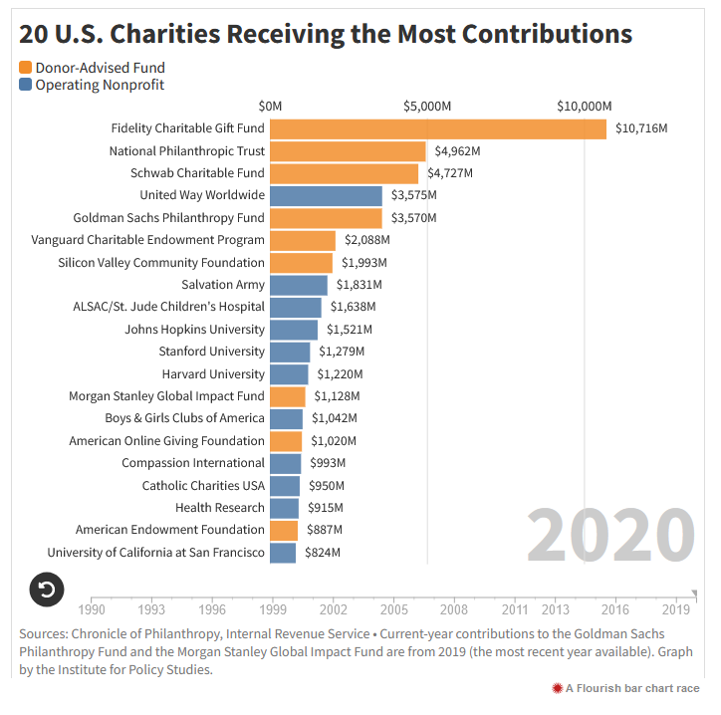
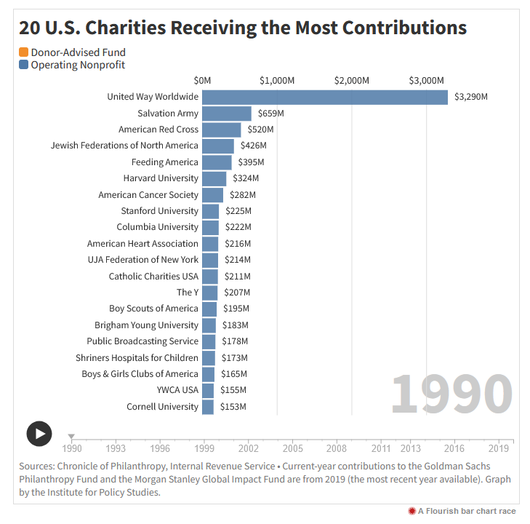
Source: https://inequality.org/great-divide/visualize-donor-advised-funds
Notes:
A good perspective can be found by looking at the list of the top 20 charities ranked by most contributions.
Here is a list going back to 1990, the year that the Fidelity Charitable Gift Fund was founded.
At the top of the list is the United Way with roughly $3.3 billion

Slide 18
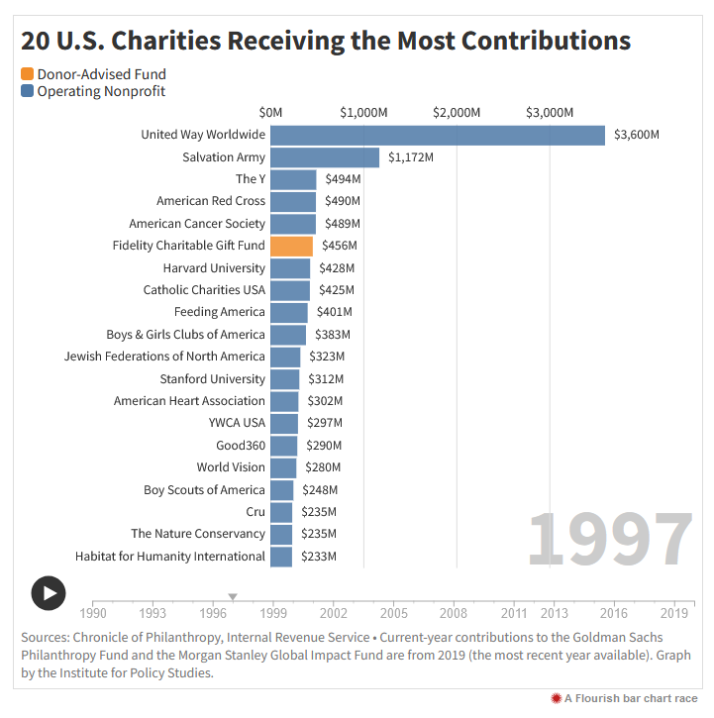
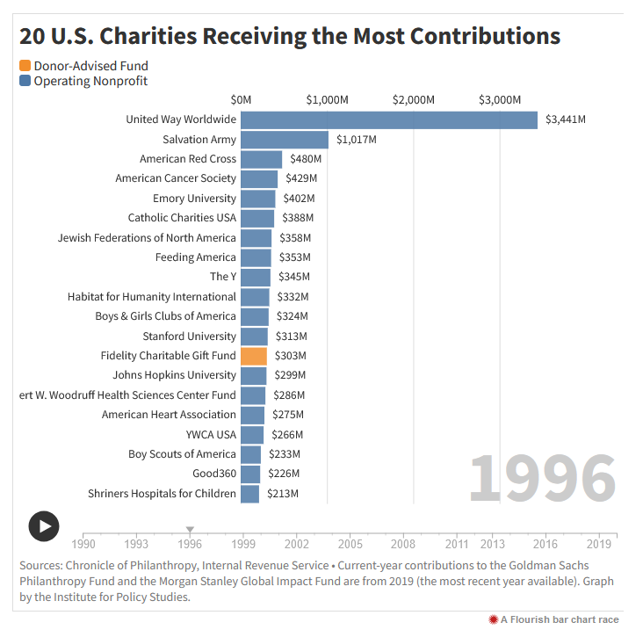
Source: https://inequality.org/great-divide/visualize-donor-advised-funds
Notes:
This is 1996.
In just six years, Fidelity has cracked the top 20.
With just over $300 million in gifts, they received more gifts that year than every other university than Emory and Stanford.

Slide 19
Source: https://inequality.org/great-divide/visualize-donor-advised-funds
Notes:
The next year, 1997, Fidelity cracked the top 10.

Slide 20
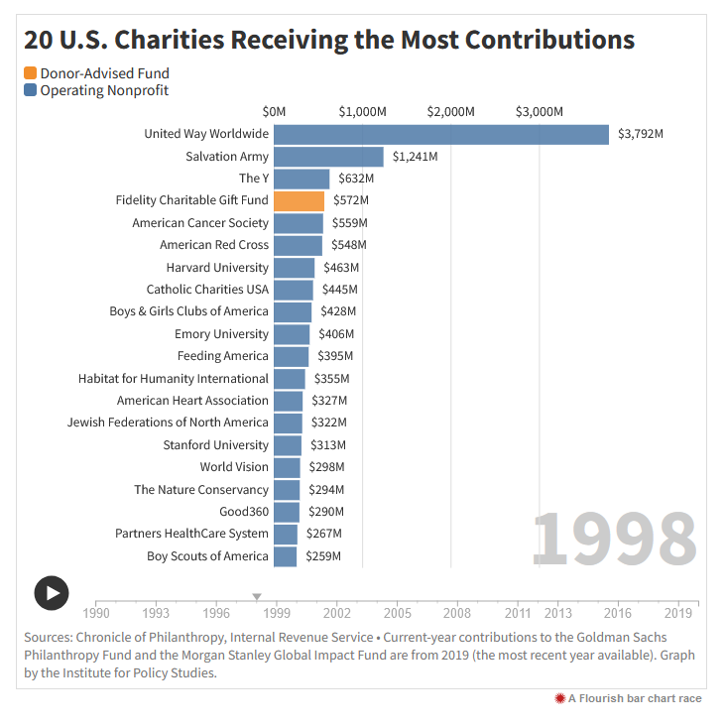
Source: https://inequality.org/great-divide/visualize-donor-advised-funds
Notes:
The next year, 1998, Fidelity cracked the top 5.

Slide 21
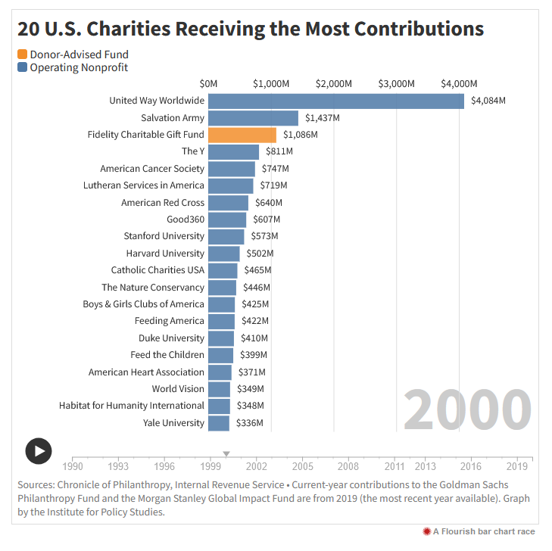
Source: https://inequality.org/great-divide/visualize-donor-advised-funds
Notes:
For roughly the next decade or so, Fidelity bounces between the top 5 and the top 10.

Slide 22
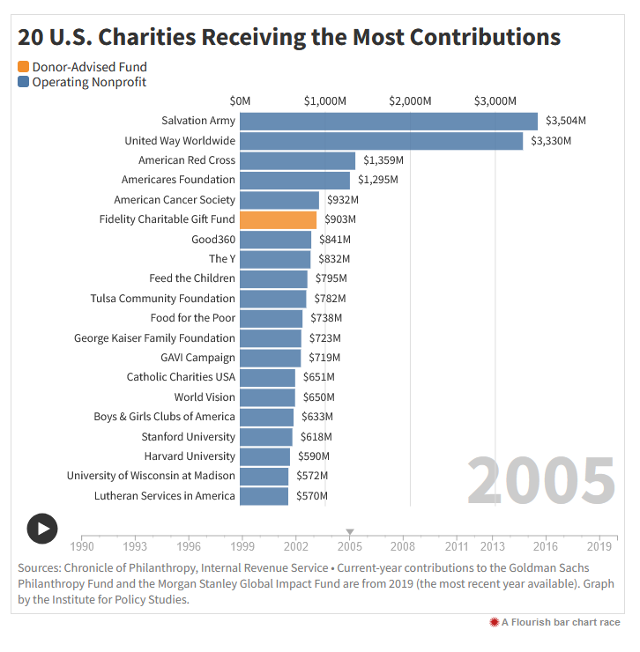
Source: https://inequality.org/great-divide/visualize-donor-advised-funds
Notes:
For roughly the next decade or so, Fidelity bounces between the top 5 and the top 10.

Slide 23
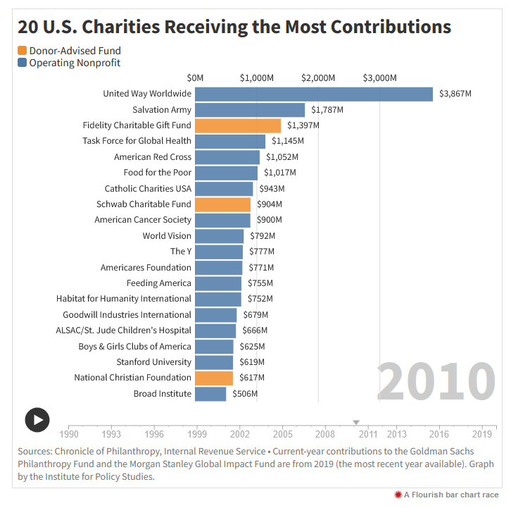
Source: https://inequality.org/great-divide/visualize-donor-advised-funds
Notes:
In 2010, three DAFs are in the top 20.

Slide 24
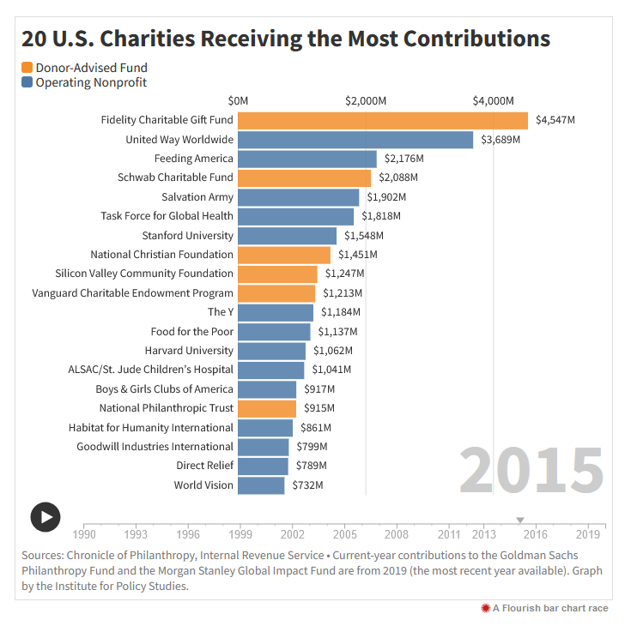
Source: https://inequality.org/great-divide/visualize-donor-advised-funds
Notes:
In 2015, six are in the top 20.
Two are in the top 5.
Fidelity surpassed the United Way as nation’s largest charity, receiving $4.5 billion as compared to $3.7 billion.

Slide 25
Source: https://inequality.org/great-divide/visualize-donor-advised-funds
Notes:
By 2020, 9 of the top 20 are DAFs.
This includes 6 of the top 10.
Fidelity raised nearly 3 times the amount of the first non-DAF on the list, the United Way.

Slide 26
Gifts to DAFs have more than doubled over last 5 years
Source:
National Philanthropic Trust
2022 DAF Report;
Billions of dollars
Notes:
Another way to see the importance of DAFs is to look at their growth rate over the past five years, where gifts more than doubled.

Slide 27
Gifts to DAFs exceeded gifts to foundations for first time in 2021
Sources:
Giving USA 2022;
National Philanthropic Trust
2022 DAF Report
Billions of dollars
Notes:
A final way to see their importance is to see how 2021 is the first in which there were more gifts to DAFs than to foundations.
DAFs have gone from a small curiosity to a significant factor in American philanthropy.

Slide 28
How can advisors
help their clients?

Slide 29
Benefits of a creating a DAF
Choosing a DAF
Existing DAFs
How can
advisors
help?
Notes:
Given the growth in DAFs, it’s inevitable that your clients may have questions.
Let’s take a look at the kinds of questions you may see.
First, let’s look at those who don’t have a DAF and look in more detail at the benefits of creating one.
Then, for those who know they want one, let’s look at questions to consider in choosing a DAF
Finally, for those who already have a DAF, let’s look at questions arising from actually using a DAF.

Slide 30
What are the
benefits of
creating a DAF?

Slide 31
Tax benefits in years of higher income
Notes:
A major reason donors give to DAFs is the mismatch between income making charitable decisions
Think about donors who have large spikes in income. They may not know what charities or projects they want to support when this spike in income happens
A DAF allows them to receive tax benefits now, make decisions later
When your donors have an event like this, a DAF may be a solution
If your client knows what they want to support, then a DAF isn’t needed.
However, your client may not know. This will especially be true during a liquidity event, when charity is far from your client’s thought process.
A DAF can establish a charitable fund now, and give you a better chance to solicit them later

Slide 32
Sale of business
Large bonus
Large capital gain distribution
Pending retirement
Move to lower tax bracket
Tax
benefits
in years of
higher
income
Notes:
Some particular situations to look for include:

Slide 33
Bunching
charitable
deductions
Notes:
With the relatively recent increase in the standard deduction, you may have already seen your clients “bunching” their charitable deductions – accelerating charitable gifts over a few years into a single year so they can itemize and realize tax savings.
If your client already knows what they want to support, a DAF isn’t needed to do this.
However, not everyone does.
A DAF can help a charitably minded person benefit from a bunching strategy while deferring grant decisions until later.

Slide 34
Simplicity
Notes:
Donors who support many charities may like the simplicity of managing their giving through a DAF.
The reason is that they only need one receipt for tax purposes – the receipt for their DAF gift – in order to realize their tax benefits

Slide 35
Tax-free growth
Notes:
Some donors may be interested in growing assets over time for a larger charitable goal.
Growth inside a donor-advised fund is tax-free.
Of course, this doesn’t increase the tax benefits, which must be taken when dollars go into the DAF.
However, it does help donors think about bigger projects, and can incent donors to commit dollars to charity now while they figure out their plans.

Slide 36
Privacy
Notes:
Remember that private foundations have to file tax returns every year. Moreover, those tax returns must be publicly available.
While the donors don’t have to be listed, the officers, balance sheet, income statement, and grant making does have to be listed.
This may not be information that you client wants readily available.
A DAF avoids this – there is no public disclosure of donor’s identity, their gifts, or their grants.

Slide 37
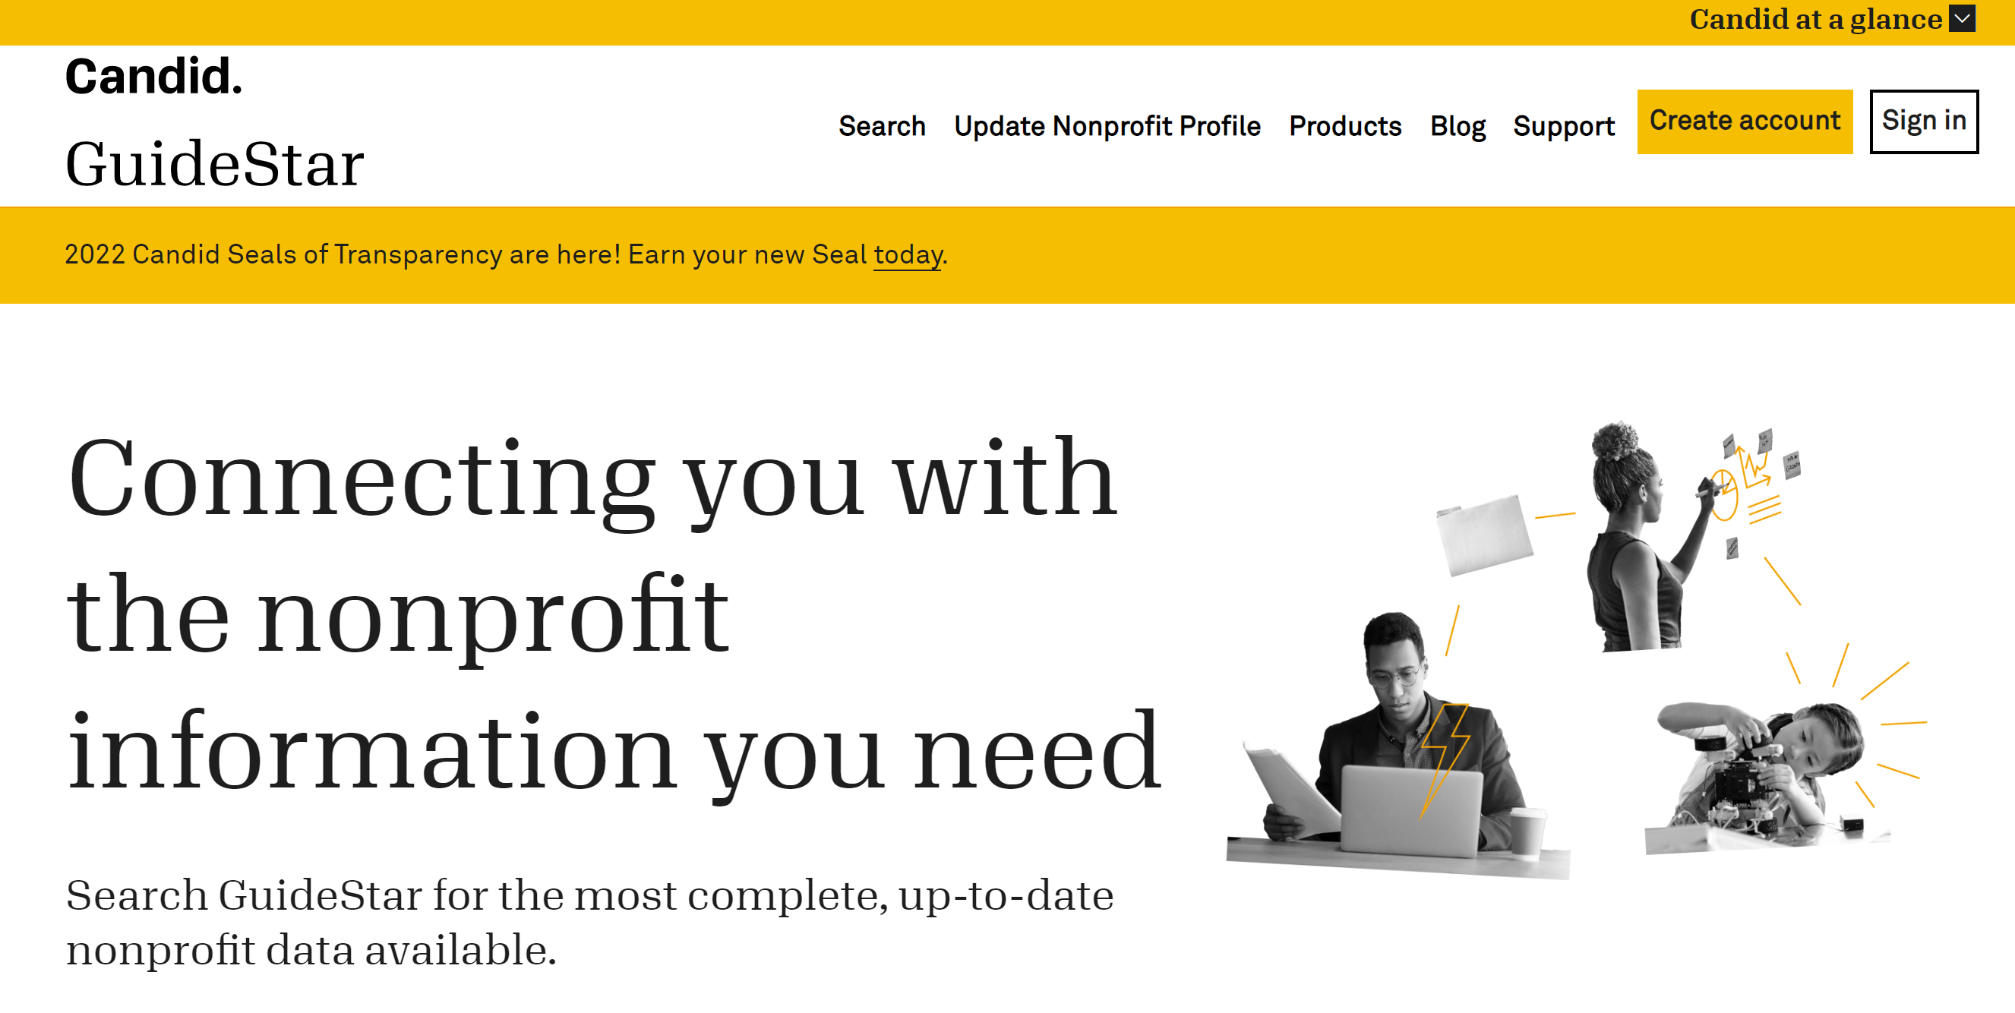
Notes:
As we talk about donor privacy, it is worthwhile to chat a little bit about Guidestar
How many of you have heard of Guidestar?
They gather data on pretty much every 501(c)(3) in existence.
For clients who are evaluating charities, Guidestar is actually quite useful.
The reason for bringing them up here is to make sure you are aware of one of their services – to publish every IRS Form 990 that is filed.
There is usually a one or two year lag.
However, Guidestar illustrates how easy for others – the press, other charities, neighbors, children – to find out information about a private foundation.
All you have to do is sign up for a free account.

Slide 38
Complex assets
Notes:
For some clients, their net worth is in complex assets.
We’ve already seen that the tax benefits of donating them to a private foundation are lower, which is why a DAF can be helpful.
However, there are other reasons why a DAF can help with complex assets.
Most small charities, and some large charities, can’t manage the risks of accepting complex assets.
These can involve carrying costs, hidden liabilities, and significant staff time to manage and liquidate.
Here’s where a DAF can help.
A number of DAFs can accept complex assets, including private business interests, real estate, even cryptocurrency.
Simply donate the complex asset, and then make grants as with any other gift.
This can give your client a safe way to use the most taxwise asset for their favored charity

Slide 39
What issues should
be considered in
choosing a DAF?

Slide 40
Technology
Notes:
Convenience may be one factor that your clients would value.
Many of the larger DAFs of technology infrastructure that makes the DAF experience similar to online banking.
Even numerous community foundations have technology devised for their platforms that can automate much of the process.

Slide 41
Guidance
and
Relationships
Notes:
Another factor is personal guidance and relationships.
By establishing a DAF with community foundation or a single issue charity, a donor is going to be able to develop relationships that can help them with their giving.
While some donors won’t care, others will value it – both the insights that such relationships can provide as well as the sense of belonging the some donors are seeking.
You won’t find meaningful relationships at Fidelity.

Slide 42
Investments
Notes:
Each DAF will have different investment choices.
Those affiliated with large mutual fund families will tend to be limited to options from that fund family, although larger accounts may have more customized options (and even the ability to name a trusted advisor for a truly custom approach).
DAFs sponsored by community foundations and single interest charity can offer best-in-class options free from bias toward any particular firm
Larger community foundations and single interest charities may be able to offer exposure to asset classes, such as private equity or hedge funds, not typically available to smaller donors.

Slide 43
Assets Accepted
Notes:
Will your DAF be able to accept the assets your client wants to donate?
Cash and publicly-traded stocks can be accepted by virtually everyone.
More complex assets – business interests, real estate, cryptocurrency – may require more evaluation of a DAF’s capabilities.

Slide 44
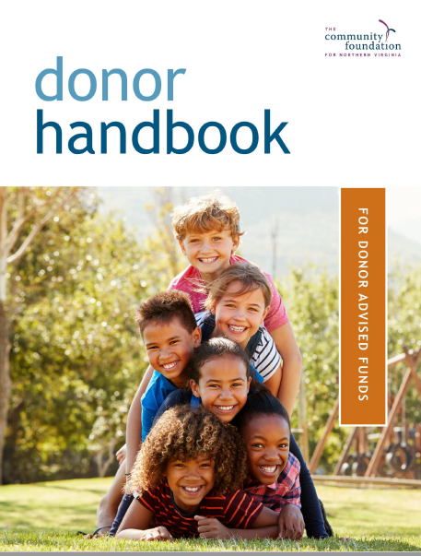
Minimum Gift and
Minimum Grant
Notes:
Minimum gift and minimum grant size may be a factor.
Most DAFs are “low dollar, high volume” DAFs – typically the financial firms and the community foundaitons.
What I mean by that is that the minimum opening gift can be relatively modest – typically no more than $25,000. Some DAFs have no minimum.
Moreover, the smallest grant size can be quite modest – I’ve seen as low as $50.
Some DAFs are “high dollar, low volume.”
These have higher minimum gifts, such as $100,000 or more, and have minimum grant sizes of $1,000 or more.
These tend to be at single issue charities, who have established DAFs to serve existing supporters.
A couple other notes.
Be aware that many funds will assess modest annual administrative fees. These are normal – this helps pay for the grantmaking process as well as investment management and accounting.
Also note that a few donor-advised funds have a mandatory 5% annual distribution requirement. This is a policy choice of those DAFs; there is no legal requirement for such a policy

Slide 45
How to help
clients with
existing DAFs?

Slide 46
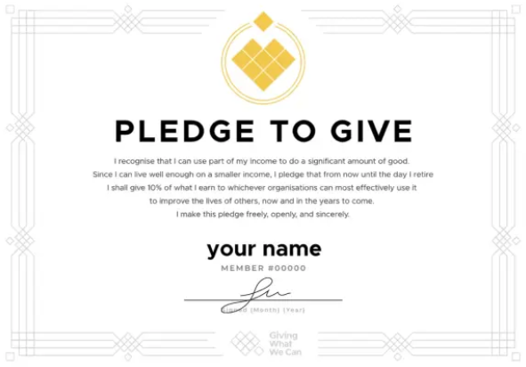
Pledges
Notes:
Pledges and DAFs can be tricky
The origin of the concern is a “prohibited benefit” excise tax that is imposed whenever a distribution provides “more than an incidental benefit”
Not only can the donor face liability (125% of the benefit), the DAF sponsor can also face a 10% excise tax if it makes such a distribution knowingly.
This is relevant to pledges because satisfying a legally binding pledge with a DAF distribution will trigger this excise tax.
The result is that DAFs would quiz charities about whether a distribution satisfies a pledge.
This can be problematic, because both donors and charities find pledges to be useful ways to manage giving.
Moreover, donors frequently create pledges and DAFs without any particular coordination, only to later run into questions.
You can help in two ways.
First, the excise tax is triggered only for “legally binding pledges” – most pledges aren’t, lacking the consideration, detrimental reliance, or statutory authority to make them enforceable.
Second, an IRS Notice several years ago specifically provided a safe harbor for DAF sponsoring charities as long as certain conditions were met. This Notice should address most pledges.
Occasionally, a pledge may need to be legally binding. If so, exercise caution. Even though this Notice provided a safe harbor for most pledges, there are other possible risks to your client. Caution is warranted.

Slide 47
Quid pro quo gifts
Notes:
Make sure your clients aren’t using the DAFs for quid pro quo gifts, as that could also trigger “prohibited benefits” liability
What is a quid pro quo gift?
Any gift in which a substantial benefit is received in exchange for the gifts
Examples:
Gala tickets
Membership fees
NPR gift premiums
Mandatory gifts for sports ticket
Charitable remainder trusts and charitable gift annuities
Rule of thumb – no DAF grant unless the gift otherwise would have generated a 100% deduction.

Slide 48
Qualified
Charitable
Distributions
Notes:
QCDs are especially popular for those over 70 ½ with an IRA
Keep in mind that neither DAFs or private foundation can accept them

Slide 49
Successors
Notes:
While most DAFs can’t last in perpetuity, most will allow successor donor advisors – for as many as one or two generations.
Just as you are asking about who holds a power of attorney and who makes health care decisions, this would be another point of inquiry for your clients.
If they have a DAF, have they named successor advisors? If so, are those choices still current?

Slide 50
Beneficiary
Designations
Notes:
Similarly, advisors should ask about beneficiary designations.
Remember, a DAF is an account at a public charity
Once there are no more donor advisors, the funds have to be used for charitable purposes
Every DAF has a process for managing this situation – either the balance will be determined by a committee at the DAF sponsor or will simply be kept by the DAF sponsor.
And that may be fine with your client.
Or it may not be.
If your client would prefer a different outcome, he or she should name one or more charitable beneficiaries to their account – essentially a testamentary grant recommendation
Just as you would ask about beneficiaries for retirement accounts and life insurance policies, this also is a question that we should be asking about.

Slide 51
QUESTIONS?
Notes:
This concludes my presentation
I have time for a few questions, and then I’ll conclude with one last slide.

Slide 52
1,285,801
$182,842
Number of DAF Accounts
Average
DAF
Size
Source: National Philanthropic Trust 2022 DAF Report
Notes:
I want to leave you with a couple of numbers
These are the number of DAF accounts in 2021 and their average size
While the average size is a nice amount, it is not the millions you find in a private foundation.
In fact, it’s less than the average house in Virginia Beach
I share these numbers just to reinforce the thought I opened with – DAFs are now a part of our landscape.
I hope this will give you a better appreciation of why knowing a bit about DAFs can help you serve your clients well

