Slide 1
Trust and Estate Scouting Report
Hampton Roads Estate Planning Council
Presented By:
Bill Sanderson, November 15, 2022

Slide 2



Bill Sanderson
@thisistherecord
@thisistherecord
CONFIDENTIAL

Slide 3

This is really where I met my wife…
CONFIDENTIAL

Slide 4
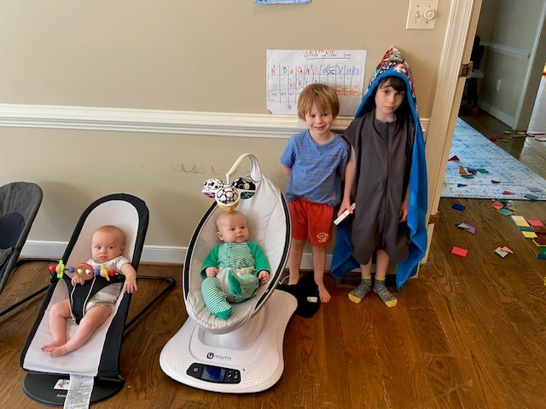
This is how I started the pandemic…
CONFIDENTIAL

Slide 5

Time Marches On…
CONFIDENTIAL

Slide 6



I used to be here…

Slide 7



You can still find me
CONFIDENTIAL

Slide 8


What I’m reading
CONFIDENTIAL

Slide 9
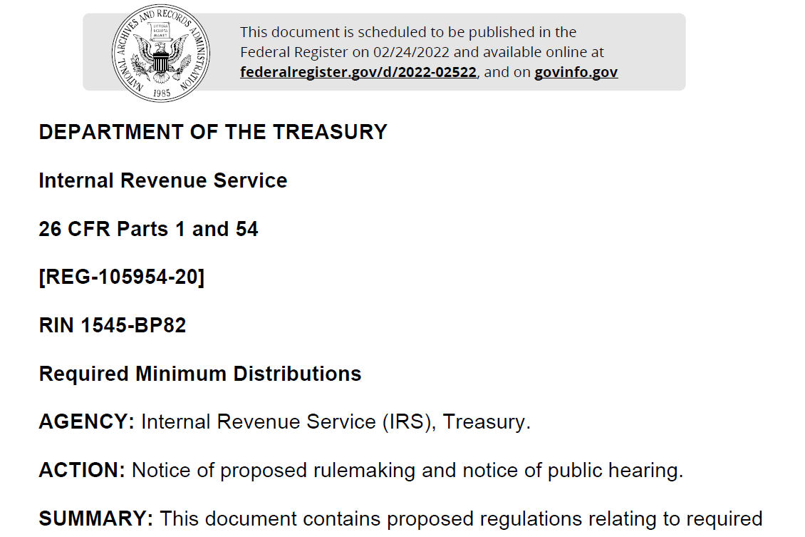
And like it or not…
CONFIDENTIAL

Slide 10

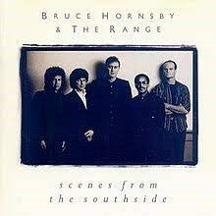
What I’m listening to…

Slide 11

Here’s something work related to listen to…
CONFIDENTIAL

Slide 12
Trust and Estate Scouting Report
Hampton Roads Estate Planning Council
Presented By:
Bill Sanderson, November 15, 2022

Slide 13

Scouting Report: Legislative and Regulatory Developments

Slide 14
Scouting Report: Legislative and Regulatory Developments
2. Washington D.C. – Administrative Roundup
This section provides headlines of interest to practitioners following IRS and Treasury administrative matters
November 10, 2022: Danny Werfel nominated to serve as IRS Commissioner, succeeding Charles Rettig.
November 4, 2022: Treasury and IRS release Priority Guidance Plan
June 28, 2022: IRS, Treasury Issue Guidance Under Section 2053 Regarding Deduction for Interest Expense and Amounts Paid Under a Personal Guarantee, Certain Substantiation Requirements, and Applicability of Present Value Concepts (REG-130975-08)
June 1, 2022: IRS Reveals First Four of 2022’s Dirty Dozen Tax Scams (IR-2022-113)
May 5, 2022: Proposed Regulations on Actuarial Tables
May 4, 2022: A Service-Wide Strategy Is Needed to Address Challenges Limiting Growth in Business Tax Return Electronic Filing (Report Number: 2022-40-036)

Slide 15
Scouting Report: Legislative and Regulatory Developments
3. Revenue Ruling 2022-20 (October 16, 2022)
Applicable Federal Rates – November 2022
Short-Term AFR (Annual Compounding) | 4.10%
Mid-Term AFR (Annual Compounding) | 3.97%
Long-Term AFR (Annual Compounding) | 3.92%
Section 7520 Rate (Annual Compounding) | 4.8%
Remember that HIGHER 7520 RATES are GOOD for QPRTs, CRATs, and CGAs and BAD for GRATs, CLATs, and private annuities; LOWER 7520 RATES are GOOD for GRATs, CLATs, and private annuities and BAD for QPRTs, CRATs, and CGAs.
CONFIDENTIAL

Slide 16
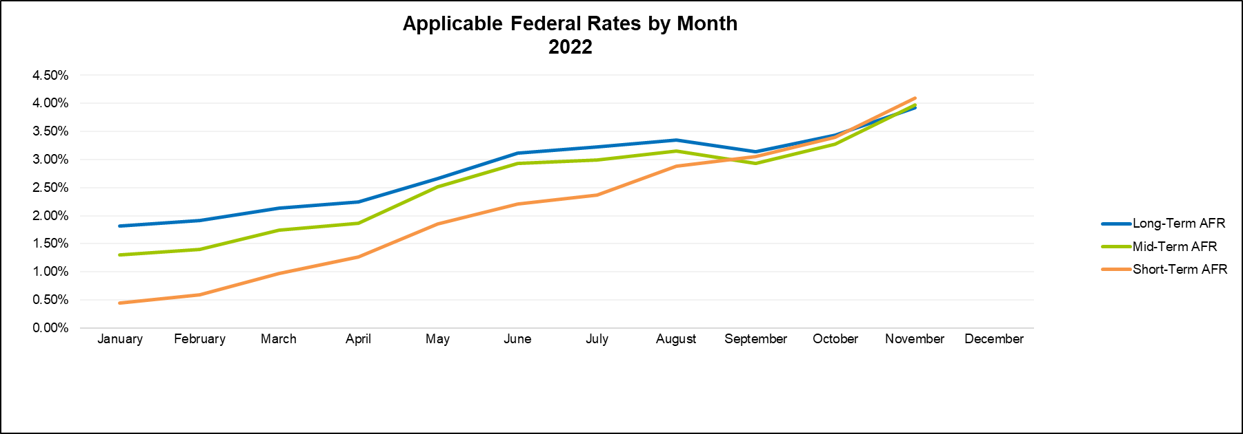
Scouting Report: Legislative and Regulatory Developments
3. Revenue Ruling 2022-20 (October 16, 2022)
CONFIDENTIAL

Slide 17
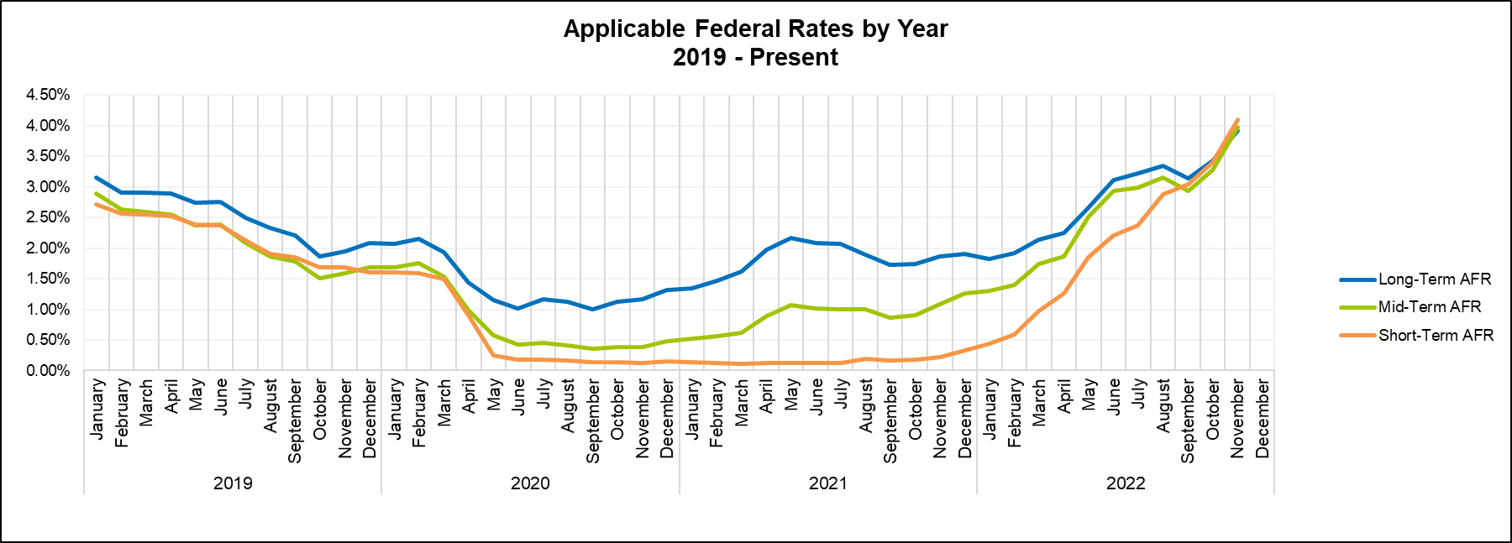
Scouting Report: Legislative and Regulatory Developments
3. Revenue Ruling 2022-20 (October 16, 2022)
CONFIDENTIAL

Slide 18
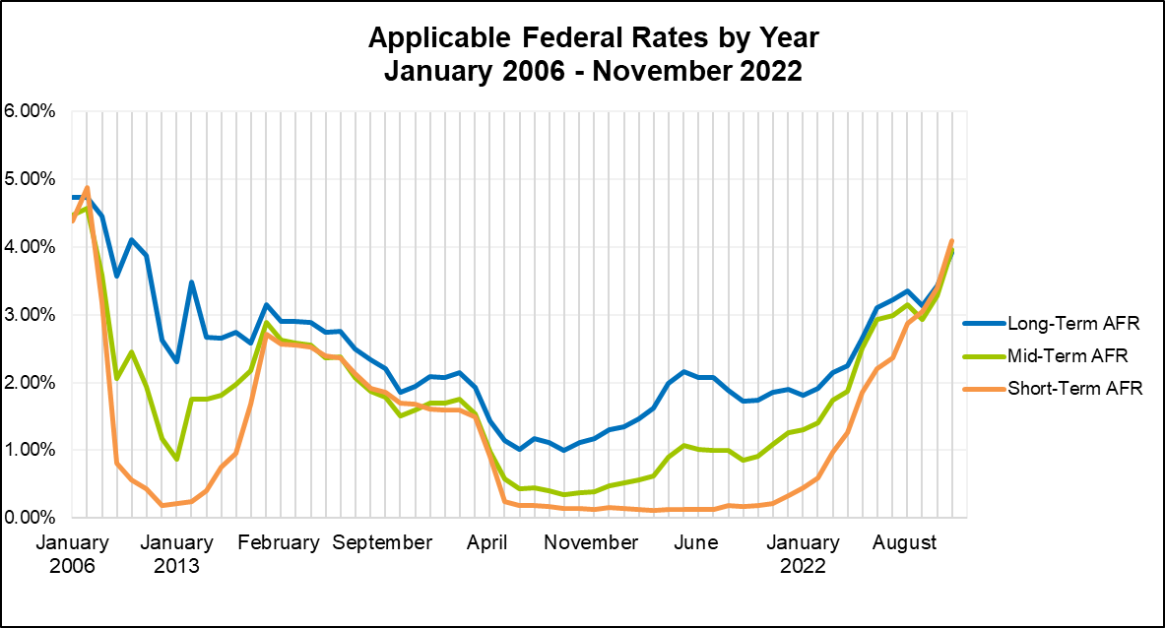
Scouting Report: Legislative and Regulatory Developments
3. Revenue Ruling 2022-20 (October 16, 2022)
CONFIDENTIAL

Slide 19
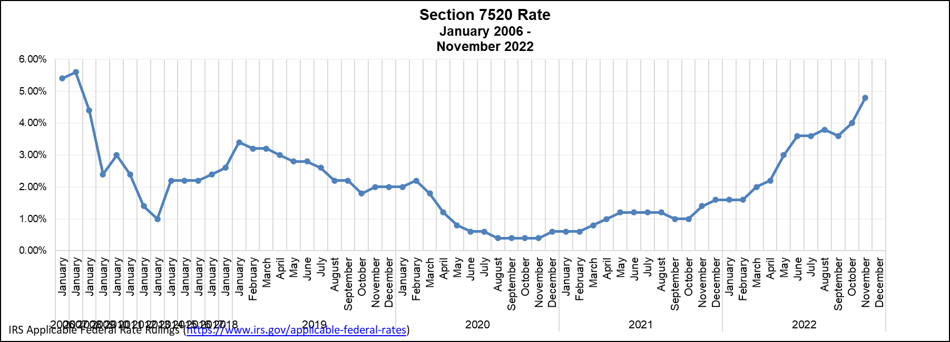
Scouting Report: Legislative and Regulatory Developments
3. Revenue Ruling 2022-18 (September 16, 2022)
CONFIDENTIAL

Slide 20
FY 2021: Estate Tax Filing Statistics
All Estate Tax Returns
Estate Tax Returns Filed in 2021 | Number of Returns | Gross Estate ($000s)
All Returns | 6,158 | 189,647,122
Under $10 million | 532 | 4,008,485
$10 million < $20 million | 3,284 | 47,162,709
$20 million < $50 million | 1,737 | 50,927,770
$50 million or more | 605 | 87,548,158
Generally, an estate files a Federal estate tax return (Form 706) in the year after a decedent's death. So, in 2021, most returns were filed for deaths that occurred in 2020, for which the filing threshold was $11.58 million of gross estate. Because of filing extensions, however, some returns were filed in 2021 for deaths that occurred prior to 2020, for which filing thresholds were lower. There are also a small number of returns filed for deaths that occurred in 2021, for which the filing threshold was $11.70 million.
Source: IRS, Statistics of Income Division
Estate Tax Returns Filed in 2021 by Tax Status and Size of Gross Estate

Slide 21
FY 2021: Estate Tax Filing Statistics
Taxable Estate Tax Returns
Estate Tax Returns Filed in 2021 | Number of Returns | Gross Estate ($000s)
All Returns | 2,584 | 98,318,430
Under $10 million | 233 | 1,738,376
$10 million < $20 million | 1,118 | 16,434,671
$20 million < $50 million | 865 | 25,504,334
$50 million or more | 369 | 54,641,049
Source: IRS, Statistics of Income Division
Estate Tax Returns Filed in 2021 by Tax Status and Size of Gross Estate

Slide 22
FY 2021: Estate Tax Filing Statistics
All Estate Tax Returns |  |  | Returns Reporting: Personal Residence
Estate Tax Returns Filed in 2021 | Number of Returns | Gross Estate ($000s) | % of Total Returns | Gross Estate ($000s)
All Returns | 6,158 | 189,647,122 | 69% | 7,005,971
Under $10 million | 532 | 4,008,485 | 54% | 253,453
$10 million < $20 million | 3,284 | 47,162,709 | 70% | 2,763,776
$20 million < $50 million | 1,737 | 50,927,770 | 73% | 2,304,832
$50 million or more | 605 | 87,548,158 | 72% | 1,683,910
This asset category includes the home identified as the decedent's residence. At most, one item of residential real estate per return is included in this asset category. Source: IRS, Statistics of Income Division Estate Tax Returns Filed in 2021 by Tax Status and Size of Gross Estate

Slide 23
FY 2021: Estate Tax Filing Statistics
All Estate Tax Returns |  |  | Returns Reporting: Other Real Estate
Estate Tax Returns Filed in 2021 | Number of Returns | Gross Estate ($000s) | % of Total Returns | Gross Estate ($000s)
All Returns | 6,158 | 189,647,122 | 79% | 14,265,395
Under $10 million | 532 | 4,008,485 | 67% | 360,921
$10 million < $20 million | 3,284 | 47,162,709 | 77% | 5,141,619
$20 million < $50 million | 1,737 | 50,927,770 | 82% | 4,388,866
$50 million or more | 605 | 87,548,158 | 87% | 4,373,989
This asset category includes commercial property, undeveloped land, real estate mutual funds (REITs), and residential property other than the personal residence. Source: IRS, Statistics of Income Division Estate Tax Returns Filed in 2021 by Tax Status and Size of Gross Estate

Slide 24
FY 2021: Estate Tax Filing Statistics
All Estate Tax Returns |  |  | Returns Reporting: Closely Held Stock
Estate Tax Returns Filed in 2021 | Number of Returns | Gross Estate ($000s) | % of Total Returns | Gross Estate ($000s)
All Returns | 6,158 | 189,647,122 | 33% | 15,830,487
Under $10 million | 532 | 4,008,485 | 21% | 153,494
$10 million < $20 million | 3,284 | 47,162,709 | 28% | 2,816,274
$20 million < $50 million | 1,737 | 50,927,770 | 37% | 3,926,063
$50 million or more | 605 | 87,548,158 | 53% | 8,934,655
This asset category includes the total value of stock held in closely held corporations. Closely held corporations are those whose ownership is concentrated among a relatively small number of owners, and whose stock is not traded publicly. Source: IRS, Statistics of Income Division Estate Tax Returns Filed in 2021 by Tax Status and Size of Gross Estate

Slide 25
FY 2021: Estate Tax Filing Statistics
All Estate Tax Returns |  |  | Returns Reporting: Cash
Estate Tax Returns Filed in 2021 | Number of Returns | Gross Estate ($000s) | % of Total Returns | Gross Estate ($000s)
All Returns | 6,158 | 189,647,122 | 99% | 17,251,450
Under $10 million | 532 | 4,008,485 | 99% | 373,154
$10 million < $20 million | 3,284 | 47,162,709 | 98% | 3,924,340
$20 million < $50 million | 1,737 | 50,927,770 | 99% | 4,199,326
$50 million or more | 605 | 87,548,158 | 99% | 8,754,630
This asset category includes all liquid assets, such as actual cash, bank accounts, certificates of deposit (CDs), money market accounts, such as Money Market Deposit Accounts (MMDAs) and Money Market Mutual Funds (MMMFs), and call and sweep accounts held in a brokerage. Source: IRS, Statistics of Income Division Estate Tax Returns Filed in 2021 by Tax Status and Size of Gross Estate

Slide 26
FY 2021: Estate Tax Filing Statistics
All Estate Tax Returns |  |  | Returns Reporting: Net Life Insurance
Estate Tax Returns Filed in 2021 | Number of Returns | Gross Estate ($000s) | % of Total Returns | Gross Estate ($000s)
All Returns | 6,158 | 189,647,122 | 37% | 1,765,186
Under $10 million | 532 | 4,008,485 | 31% | 48,569
$10 million < $20 million | 3,284 | 47,162,709 | 38% | 835,029
$20 million < $50 million | 1,737 | 50,927,770 | 37% | 441,830
$50 million or more | 605 | 87,548,158 | 37% | 439,758
This asset category includes the value of includible life insurance, net of policy loans. Includible insurance is any insurance on the decedent's life that is payable to the estate at the decedent's death or is payable to another beneficiary if the decedent retained some ownership of the policy. Source: IRS, Statistics of Income Division Estate Tax Returns Filed in 2021 by Tax Status and Size of Gross Estate

Slide 27
FY 2021: Estate Tax Filing Statistics
All Estate Tax Returns |  |  | Returns Reporting: Farm Assets
Estate Tax Returns Filed in 2021 | Number of Returns | Gross Estate ($000s) | % of Total Returns | Gross Estate ($000s)
All Returns | 6,158 | 189,647,122 | 13% | 4,898,593
Under $10 million | 532 | 4,008,485 | 12% | 130,733
$10 million < $20 million | 3,284 | 47,162,709 | 13% | 1,741,153
$20 million < $50 million | 1,737 | 50,927,770 | 13% | 1,357,779
$50 million or more | 605 | 87,548,158 | 19% | 1,668,928
This asset category includes farm land and assets used in conjunction with a farm or agricultural business, as well as incorporated farms, farm partnerships, and farm sole proprietorships. Source: IRS, Statistics of Income Division Estate Tax Returns Filed in 2021 by Tax Status and Size of Gross Estate

Slide 28
FY 2021: Estate Tax Filing Statistics
All Estate Tax Returns |  |  | Returns Reporting: Private Equity / Hedge Funds
Estate Tax Returns Filed in 2021 | Number of Returns | Gross Estate ($000s) | % of Total Returns | Gross Estate ($000s)
All Returns | 6,158 | 189,647,122 | 19% | 6,930,875
Under $10 million | 532 | 4,008,485 | 12% | 52,409
$10 million < $20 million | 3,284 | 47,162,709 | 15% | 408,232
$20 million < $50 million | 1,737 | 50,927,770 | 21% | 809,360
$50 million or more | 605 | 87,548,158 | 37% | 5,660,874
This asset category includes both private equity funds and hedge funds. Usually structured as limited partnerships, these private investment funds are typically open to a limited range of professional and wealthy investors and pay performance fees to their investment managers. Source: IRS, Statistics of Income Division Estate Tax Returns Filed in 2021 by Tax Status and Size of Gross Estate

Slide 29
FY 2021: Estate Tax Filing Statistics
All Estate Tax Returns |  |  | Returns Reporting: Retirement Assets
Estate Tax Returns Filed in 2021 | Number of Returns | Gross Estate ($000s) | % of Total Returns | Gross Estate ($000s)
All Returns | 6,158 | 189,647,122 | 68% | 8,737,658
Under $10 million | 532 | 4,008,485 | 59% | 372,087
$10 million < $20 million | 3,284 | 47,162,709 | 70% | 4,073,232
$20 million < $50 million | 1,737 | 50,927,770 | 68% | 2,640,923
$50 million or more | 605 | 87,548,158 | 63% | 1,651,416
This asset category includes annuities, assets held in defined contribution plans, such as Individual Retirement Accounts (IRAs) and 401(k)s, and the taxable portion of survivor benefits from defined benefit plans such as traditional employer pensions. Source: IRS, Statistics of Income Division Estate Tax Returns Filed in 2021 by Tax Status and Size of Gross Estate

Slide 30
FY 2021: Estate Tax Filing Statistics
All Estate Tax Returns |  |  | Returns Reporting: Art
Estate Tax Returns Filed in 2021 | Number of Returns | Gross Estate ($000s) | % of Total Returns | Gross Estate ($000s)
All Returns | 6,158 | 189,647,122 | 21% | 3,535,363
Under $10 million | 532 | 4,008,485 | 16% | 21,224
$10 million < $20 million | 3,284 | 47,162,709 | 16% | 177,776
$20 million < $50 million | 1,737 | 50,927,770 | 25% | 508,496
$50 million or more | 605 | 87,548,158 | 45% | 2,827,866
This asset category includes items such as paintings, sculptures, busts, engravings, and etchings. Source: IRS, Statistics of Income Division Estate Tax Returns Filed in 2021 by Tax Status and Size of Gross Estate

Slide 31
FY 2021: Estate Tax Filing Statistics
All Estate Tax Returns |  |  | Returns Reporting: Total Lifetime Transfers
Estate Tax Returns Filed in 2021 | Number of Returns | Gross Estate ($000s) | % of Total Returns | Gross Estate ($000s)
All Returns | 6,158 | 189,647,122 | 59% | 85,797,140
Under $10 million | 532 | 4,008,485 | 52% | 1,333,822
$10 million < $20 million | 3,284 | 47,162,709 | 56% | 17,803,080
$20 million < $50 million | 1,737 | 50,927,770 | 64% | 21,883,350
$50 million or more | 605 | 87,548,158 | 71% | 44,776,888
Total lifetime transfers equals the sum of all assets that were given by the decedent to others during life and were includible in his/her gross estate under sections 2035(a), 2036, 2037, or 2038 of the Internal Revenue Code. Source: IRS, Statistics of Income Division Estate Tax Returns Filed in 2021 by Tax Status and Size of Gross Estate

Slide 32
Scouting Report: Legislative and Regulatory Developments
  5. REG-105954-20 – SECURE Act Proposed Regulations (February 24, 2022)
Treasury issues proposed regulations relating to requirement minimum distribution rules; clarifies 10-year distribution requirement

Slide 33
Scouting Report: Marital Deduction
  Kucerak v. United States, No. 5:22-cv-00007 (W.D. Tex) (January 7, 2022)
Estate of a decedent who was in a same-sex relationship as of her date of death files for a refund of estate tax, seeking to have her relationship recognized as a common-law marriage under applicable law and to qualify for the marital deduction under Obergefell

Slide 34
Scouting Report: Gift Tax
  20. Smaldino v. Commissioner, T.C. Memo 2021-127 (2021)
Tax Court reviews gifts made by husband and wife. Rules that wife never was an actual owner able to make gifts and gifts were deemed made by husband.

Slide 35
Scouting Report: Other Cases of Interest
  54. Sander v. Comm'r of Internal Revenue, T.C. Memo 2022-103 (October 6, 2022)
Tax Court evaluates gifts made by husband and wife; finds that the husband is the actual transferor

Slide 36
Scouting Report: Other Cases of Interest
  55. Busch v. Commissioner (U.S. Tax Court, No. 14085-20S)
Tax Court requires careful review before filing

Slide 37

Questions or Comments?
Michael Barker
mbarker@mcguirewoods.com
Bill Sanderson
wsanderson@mcguirewoods.com

