Slide 1
The RUFADAA Triangle: Navigating Digital Assets Under The Revised Uniform Fiduciary Access To Digital Assets Act
M.R. Litman | Virginia Estate & Trust Law

Slide 2
AGENDA
Introduction
What does the Act do?
What is the role of the custodian?
Why is the Act necessary?
Why should we care?
Takeaways

Slide 3
Privacy
RUFADAA is model legislation that has been enacted in Virginia. The creation of the original UFADAA by the Uniform Law Commission had three major components (3 points of triangle):
Contract
Consent

Slide 4
Privacy
If a user doesn’t want their
information shared with a fiduciary after
death or incapacity, a custodian should protect
the user’s privacy.

Slide 5
Consent
Original UFADAA was
based on the concept that
a fiduciary had the account
holder’s implied consent and didn’t
need actual consent, so a custodian could
voluntarily disclose content under the “lawful
consent” exception of the Stored Communications
Act, but the SCA is silent on fiduciaries. Custodians argued
a fiduciary cannot fully stand in the shoes of the user without
some additional consent.

Slide 6
Contract
How does UFADAA interact
with existing TOSAs? Does UFADAA
override TOSAs and make them null and
void? Does UFADAA make TOSAs more difficult
to implement and time consuming to complete?

Slide 7
RUFUADAA was a total re-write of the original act, released September 28, 2015, based on feedback the ULC received from custodians.
However, these 3 points remain the framework of how we deal with digital assets.
Now, we operate with 6 additional, clarifying points:
Online-tool concept
Content v. catalogue
Presumptive access v. possible access
Disclosure
Court intervention
Protection for custodians

Slide 8
The act
Effective July 1, 2017, Virginia adopted the Revised Uniform Fiduciary Access to Digital Assets Act (the “Act”), codified as Virginia Code §§ 64.2-116 to 64.2-132.

Slide 9
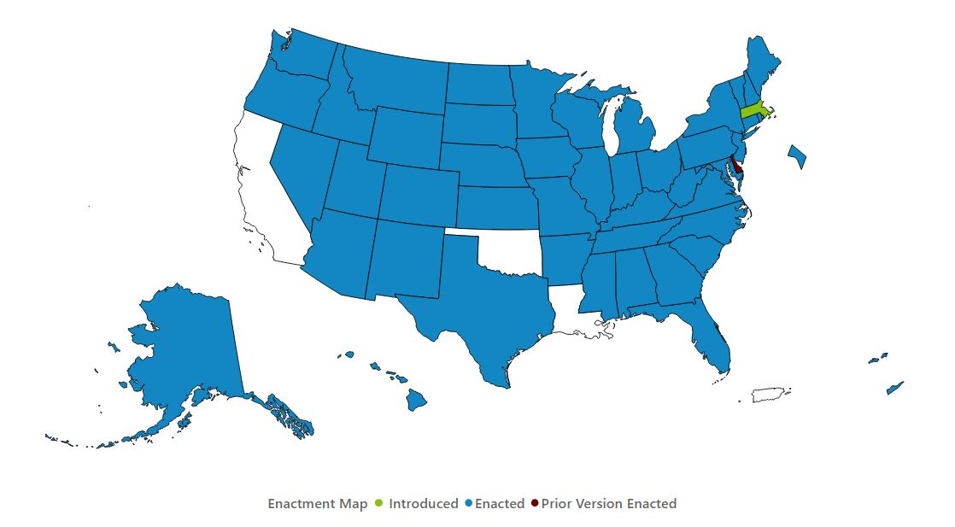
Uniform Law Commission

Slide 10
What Does the Act Do?
The Act modernizes fiduciary law in the age of the internet, working with Virginia’s existing laws on probate, guardianship, conservatorship, trusts, and powers of attorney.
The Act does not change other laws applicable to fiduciaries.
The Act provides legal authority for fiduciaries to manage digital assets in accordance with users’ estate plans, while protecting users’ private communications from unintended disclosure.

Slide 11
A “digital asset” is an electronic record a user owns or has a right or interest in.
Digital Assets
Emails
Social media accounts
Internet domain names
Medical records
Digital art (photographs, music)
Client lists
Software
Travel accounts
Online gaming pieces
Bitcoins
Electronic bank & investment account statements
Not Digital Assets
Underlying assets, unless the assets themselves are electronic records

Slide 12
A “custodian” is an individual or company who processes, receives, or stores digital assets for users.
An “online tool” is an electronic service provided by a custodian that allows a user, in an agreement separate from a terms of service agreement (“TOSA”), to provide directions for disclosure or nondisclosure of digital assets to a third person.

Slide 13
The Act addresses access to digital assets for four types of fiduciaries:
Personal representatives of deceased persons’ estates;
Guardians and conservators of protected persons’ estates;
Agents under powers of attorney; and
Trustees of trusts.

Slide 14
What is the Custodian’s Role?
A user can specify whether a custodian should preserve, distribute, or destroy his or her digital assets.
How the user indicates his or her directions for digital assets depends on whether the custodian provides an online tool for access to the assets.
If the custodian provides an online tool, the Act makes the user’s online instructions via the online tool legally enforceable.
If the custodian does not provide an online tool or if the user declines to use the tool, the user may give legally enforceable directions for the preservation, distribution, or destruction of digital assets in a will, power of attorney, or other record.

Slide 15
What is the Custodian’s Role?
If the user has not provided any direction, the custodian’s terms of service for the user’s account determine whether the fiduciary may access the digital assets.
When disclosing a user’s digital assets, the custodian has the discretion to grant the fiduciary full or partial access to the user’s account, as long as the access allows the fiduciary to perform his or her required tasks.
The custodian may provide the fiduciary with a copy in a record of the digital assets that the user could have accessed had he or she been alive or had full capacity at that time.

Slide 16
What is the Custodian’s Role?
The Act contemplates that custodians have different business models and methods for disclosure.
The Act allows custodians to assess reasonable administrative charges.
If a user deletes an asset, the custodian does not need to disclose the deleted asset.
If a custodian receives an unduly burdensome request, it may decline to disclose the digital asset.
The custodian (and the fiduciary) may seek guidance from a court maintaining jurisdiction over the assets.

Slide 17
What is the Custodian’s Role?
The custodian must respond to the fiduciary’s request for access to the digital asset within sixty days of receiving proper proof of the fiduciary‘s authority to access the assets.
Proper proof may be:
a certified letter of appointment;
a court order;
a power of attorney expressly granting the requisite authority; or
a certified copy of the trust instrument.

Slide 18
What is the Custodian’s Role?
A custodian who complies with a fiduciary’s request for access is immune from liability.
Remember: Just because a fiduciary has access to digital assets doesn’t mean the fiduciary owns the assets or may engage in transactions with the assets!

Slide 19
Why is the Act Necessary?
The average person under 70 years old has more than 160 digital accounts (per Legacy Concierge).
As of 2021:
72% of Americans used some form of social media (Pew Research);
71% of small businesses owned their own websites (Top Design Firms);
The world’s cryptocurrency was worth over $3 trillion (Time); and
According to FBI stats, reported monetary losses from digital asset scams were nearly 600% higher than in 2020.

Slide 20
Why is the Act Necessary?
2014 global survey by McAfee: average person has digital assets worth $35,000.
Growth of digital assets has outpaced state and federal law governing such assets.
Many TOSAs do not contemplate that death or incapacity may prevent access to digital assets.

Slide 21
Why is the Act Necessary?
Fourth Amendment does not adequately cover digital assets.
Stored Communications Act and Computer Fraud and Abuse Act are barriers for fiduciaries.
Most state probate codes are silent on digital assets.
Real life examples:
Leonard Bernstein’s “Blue Ink” manuscript;
In re Estate of Ellsworth, No. 2005-296, 651-DE (Mich. Prob. Ct. Mar. 4, 2005);
QuadrigaCX; and
Ricky and Diane Rash.

Slide 22
Why Do Clients Need to Plan?
Clients need to include specific language in their estate planning documents authorizing custodians to release data to fiduciaries during incapacity or death.
The Act amends the Uniform Power of Attorney Act (specifically Virginia Code § 64.2-1622) to provide an agent may act on behalf of a principal regarding the content of an electronic communication of the principal only if the power of attorney document expressly grants the agent the authority.
Clients need to keep and maintain comprehensive inventories of digital assets and how to access each asset.

Slide 23
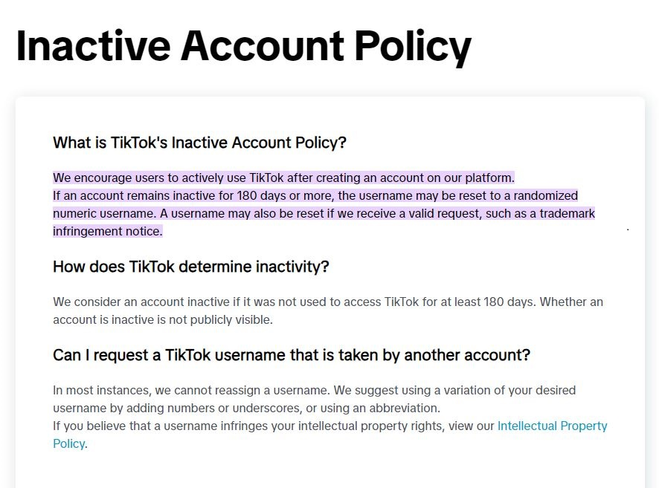
TikTok

Slide 24
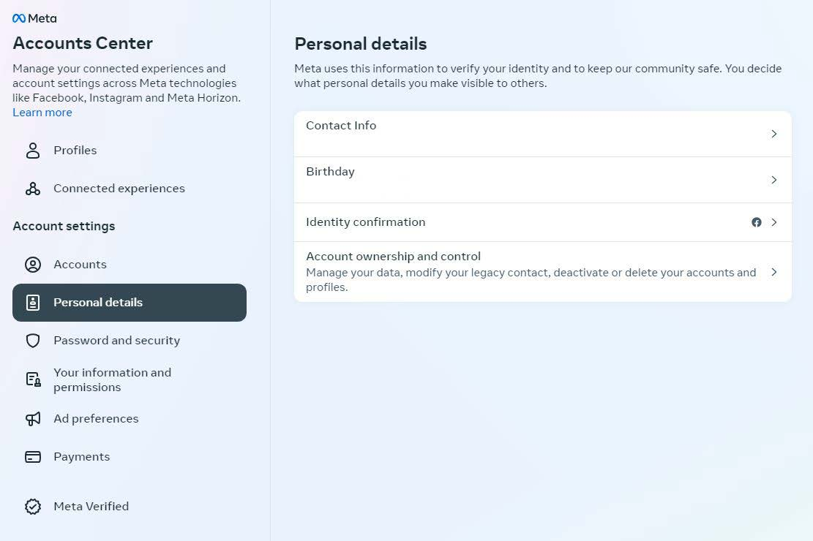
Facebook

Slide 25
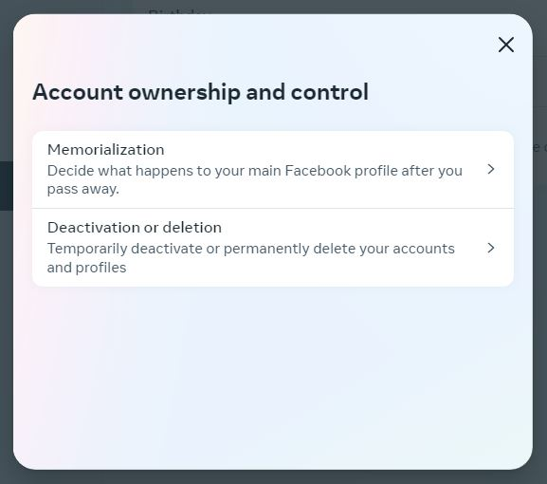
Facebook

Slide 26
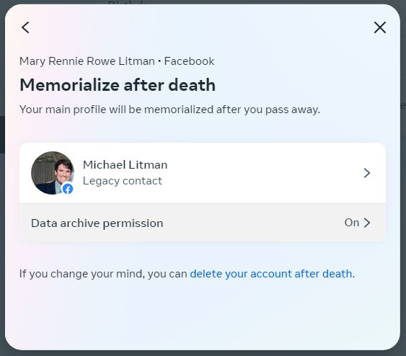
Facebook

Slide 27
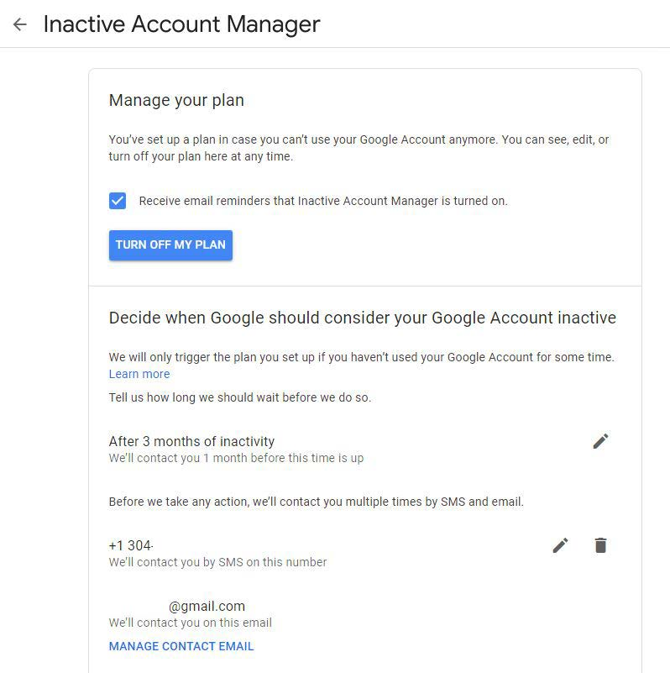
Google

Slide 28
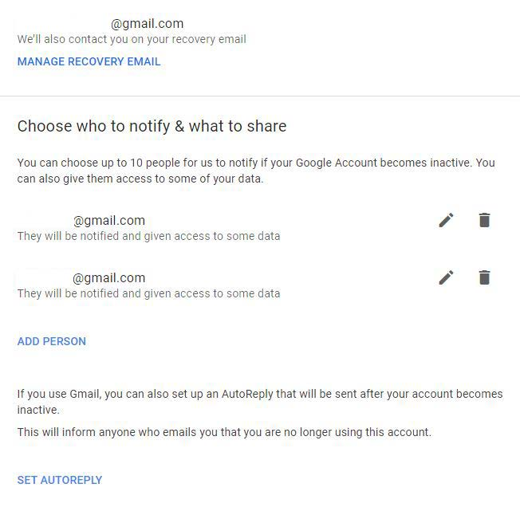
Google

Slide 29
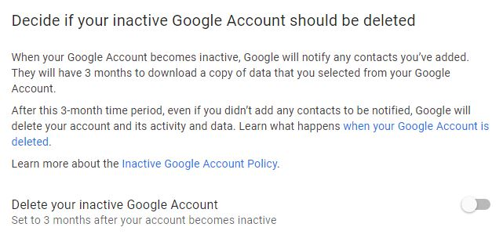
Google

Slide 30
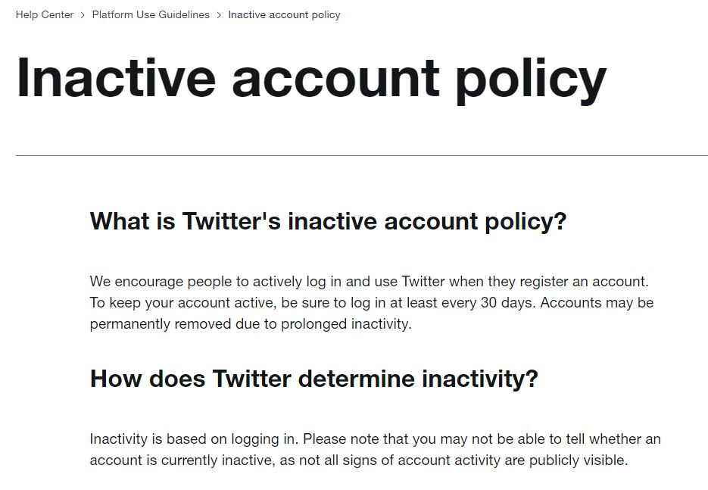
Twitter / x

Slide 31
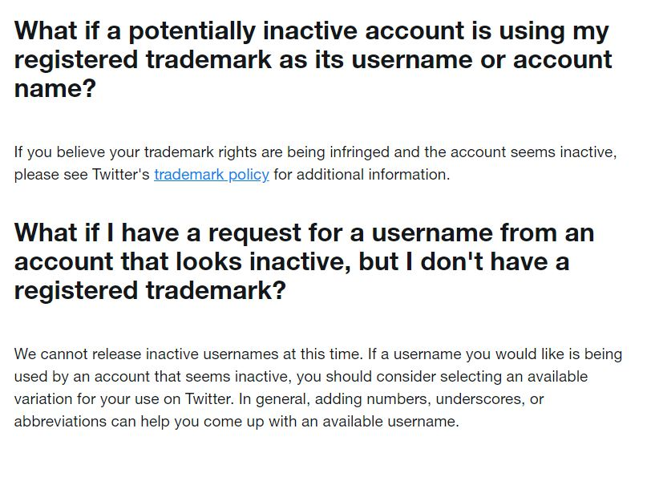
Twitter / x

Slide 32
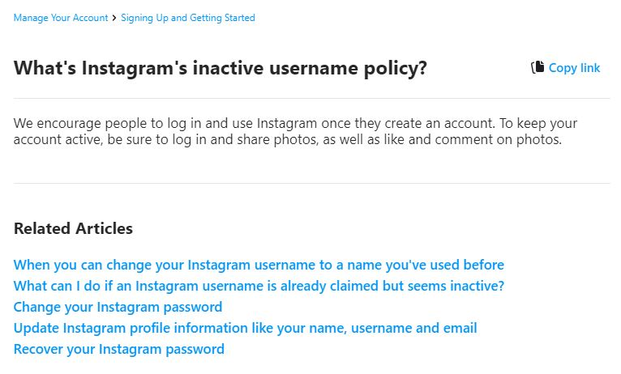
Instagram

Slide 33
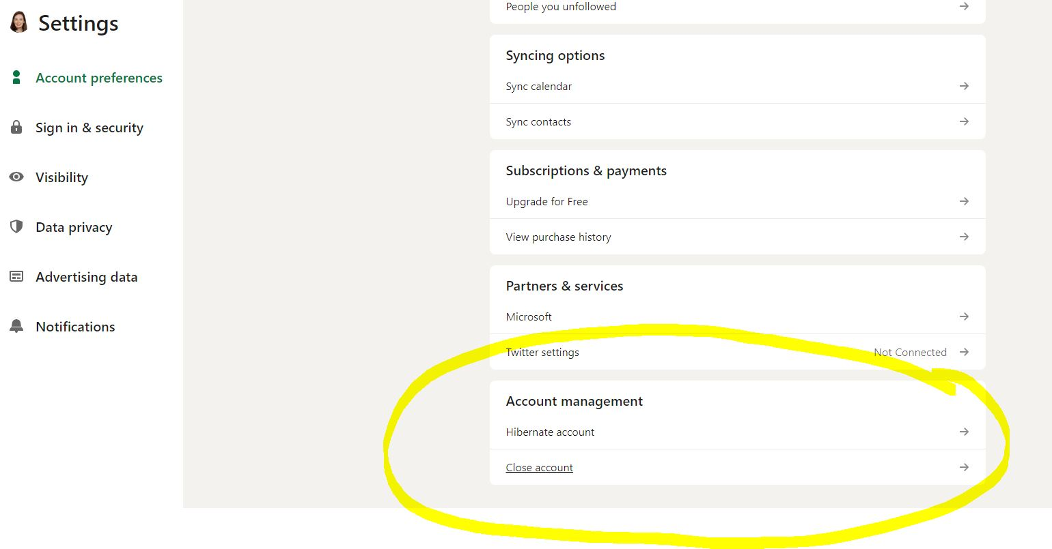
Linkedin

Slide 34
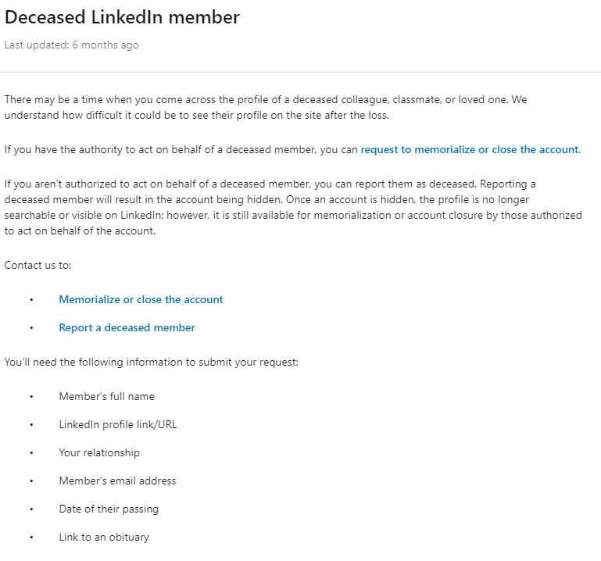
Linkedin

Slide 35
Linkedin

Slide 36
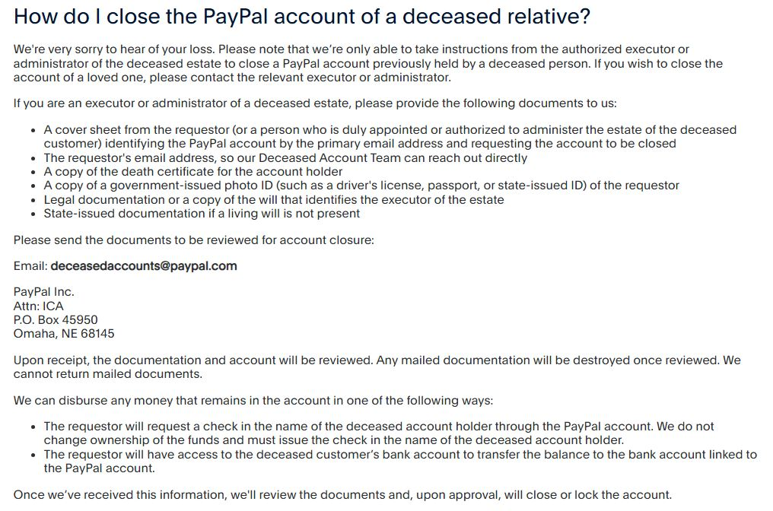
PayPal

Slide 37
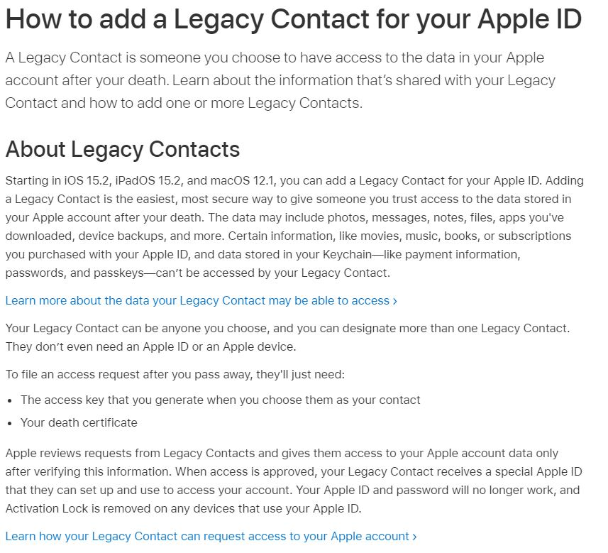
Apple

Slide 38
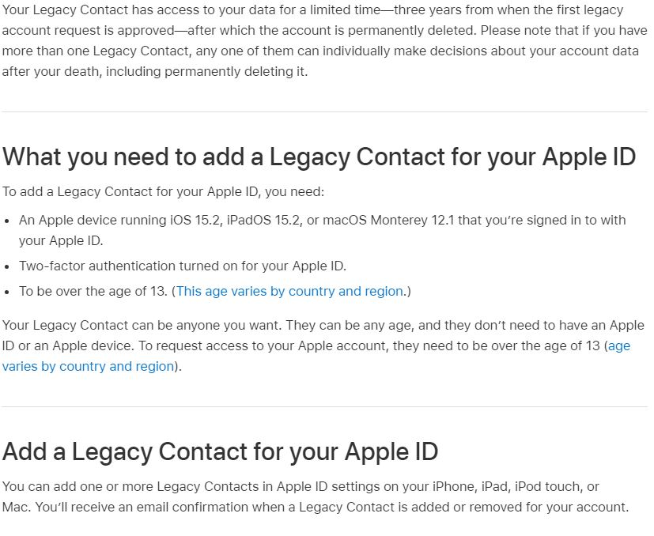
Apple

Slide 39
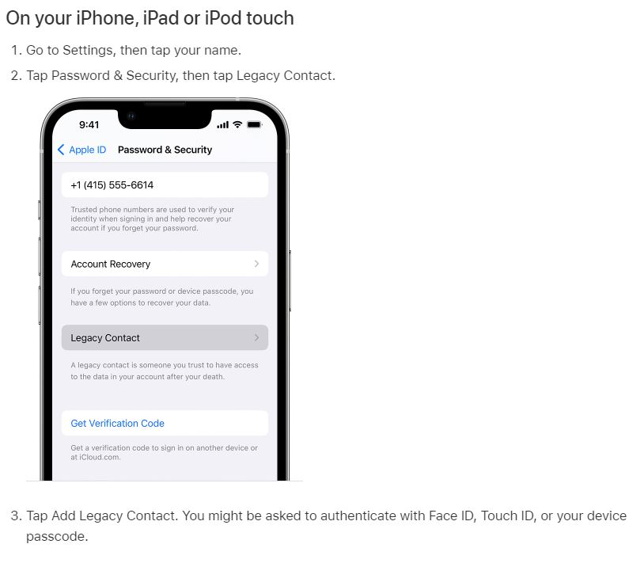
Apple

Slide 40
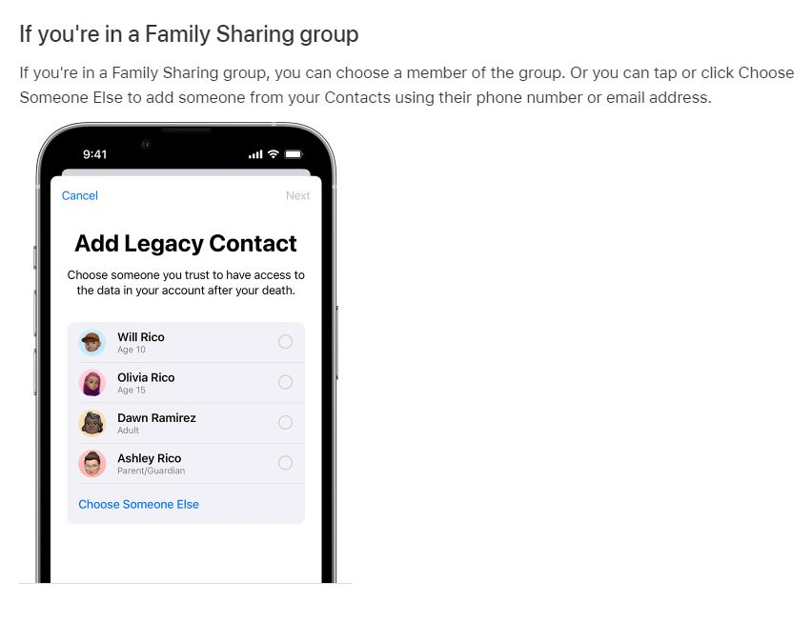
Apple

Slide 41
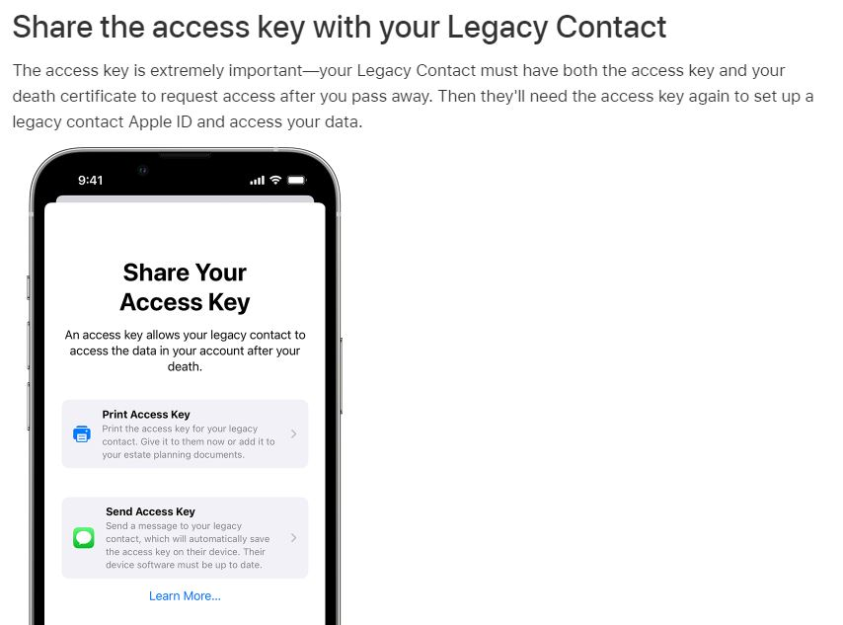
Apple

Slide 42
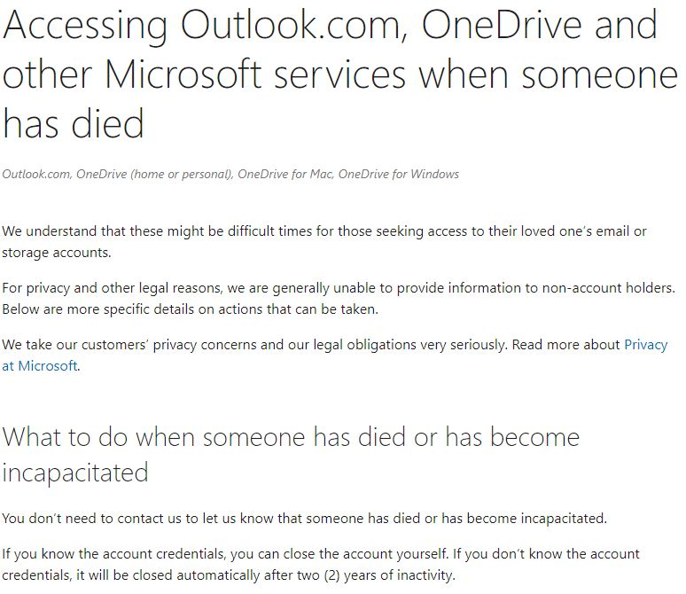
Microsoft

Slide 43
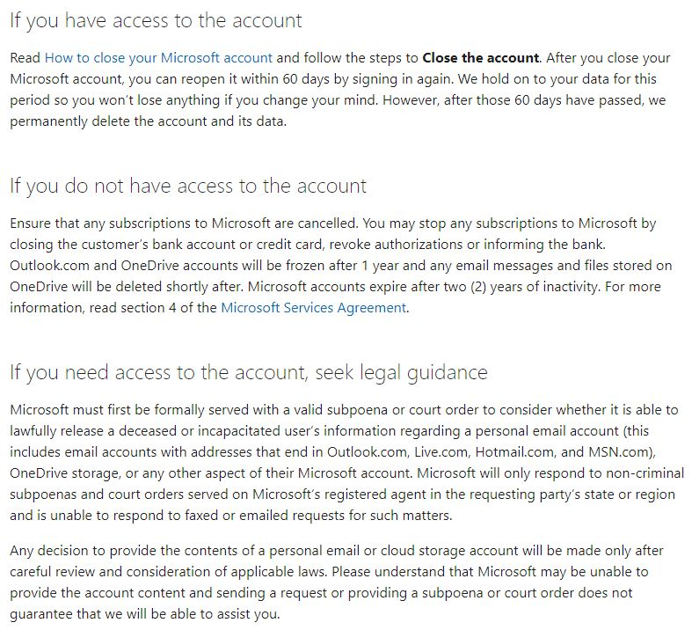
Microsoft

Slide 46
Takeaways
The Act fills in the missing and gray areas in existing banking, contract, criminal, and other laws applicable to fiduciaries.
The Act provides legal authority for fiduciaries to manage digital assets in accordance with users’ estate plans.
The Act addresses access for personal representatives, guardians, conservators, agents under powers of attorney, and trustees.
The user can specify whether the custodian should preserve, distribute, or destroy his or her assets.
How the user indicates his or her directions depends on whether the custodian provides an online tool.

Slide 47
Takeaways
The Act gives the custodian the discretion to grant full or partial access to a user’s account.
The Act contemplates that custodians have different business models and methods for disclosure.
Custodians who comply with the Act and a fiduciary’s request for access within sixty days are immune from liability.
Just because a fiduciary has access to a digital asset does not mean the fiduciary owns the assets or may engage in transactions with the assets.

Slide 49
Questions?
M.R. Litman
(804) 592-3568
mlitman@vaetlaw.com

