Slide 1
Economic Update
Hampton Roads Estate Planning Council
March 28, 2023
Joseph Mengedoth, CBE
Regional Economist
Research Department
The views and opinions expressed herein are those of the author. They do not represent an official position of the Federal Reserve Bank of Richmond or the Federal Reserve System.

Slide 2
How did we get here and where are we now?
Strong consumer demand + supply challenges = higher prices
  Demand surged during COVID and production struggled to meet it
  Supply chains impacted by labor shortages and limited resources; global commodity prices rose; war in Ukraine
  Businesses passed along rising costs, driving consumer prices up
  Consumers slowly normalizing back to spending more on services
Current Economy:
  Inflation has eased somewhat but remains well above the 2% target; Fed is committed to reducing inflation by raising the borrowing rate
  Lots of talk about a recession but no strong evidence we’re headed for one; consumer spending still growing at healthy rate; some notable slowing in interest rate sensitive segments like real estate
  Strong job growth nationally; but slower in Virginia, particularly in larger metros

Slide 3
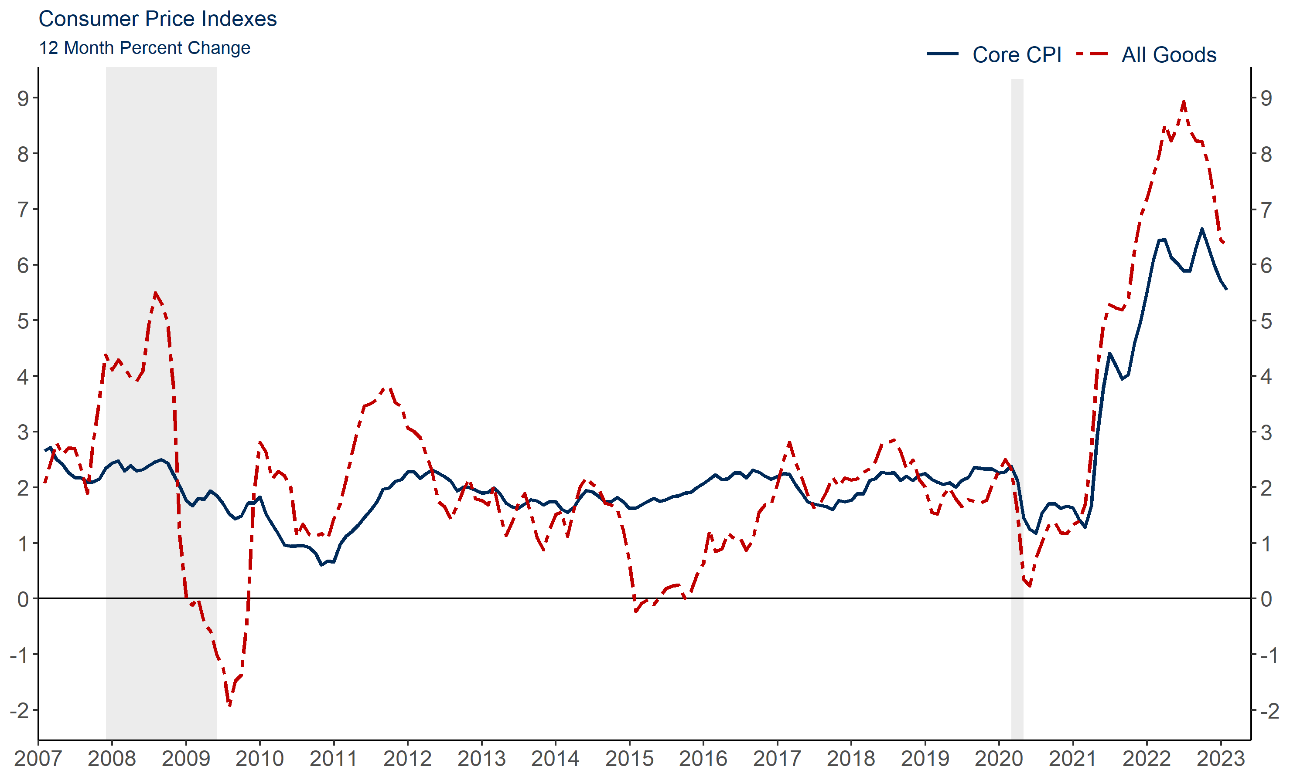
Consumer prices easing but still growing strongly
Source: Bureau of Labor Statistics/ Haver Analytics

Slide 4
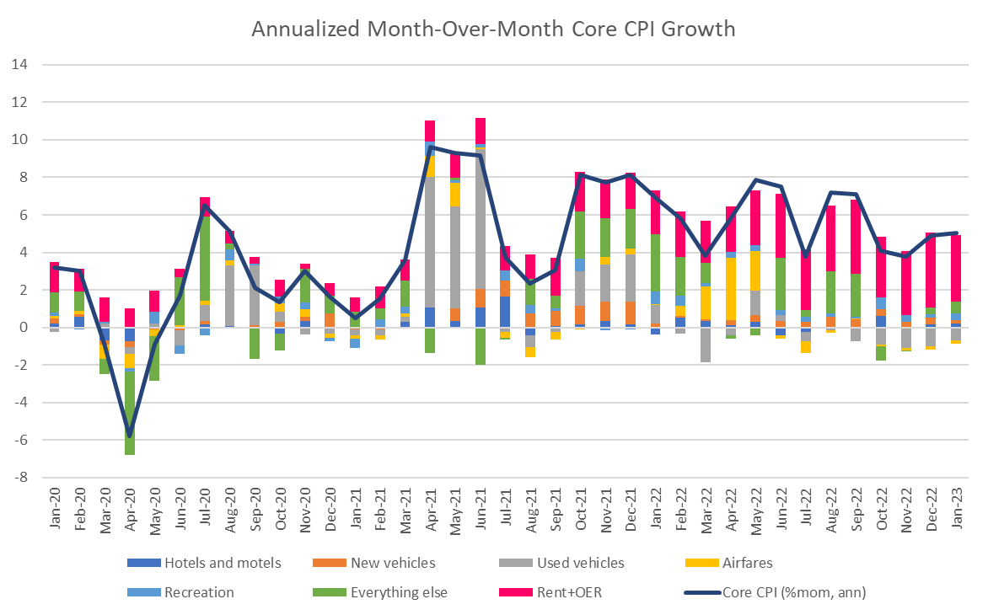
The month-to-month data show that housing costs are a big driver of inflation right now

Slide 5
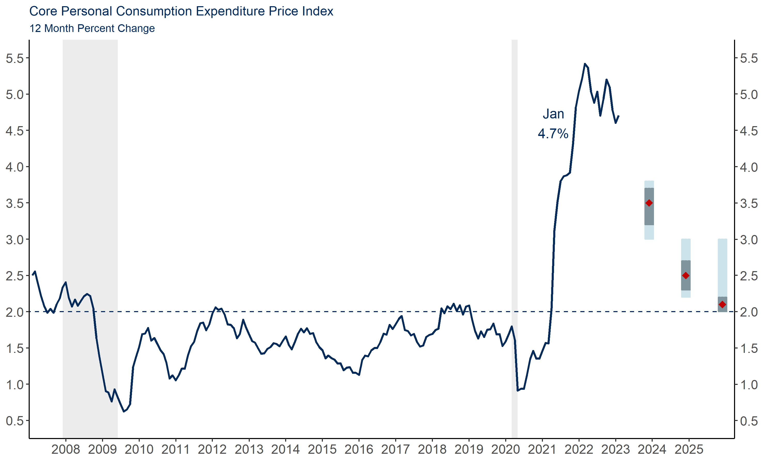
Fed’s preferred inflation measure is also coming down slowly
Source: Bureau of Economic Analysis via Haver Analytics and Federal Reserve Board of Governors

Slide 6
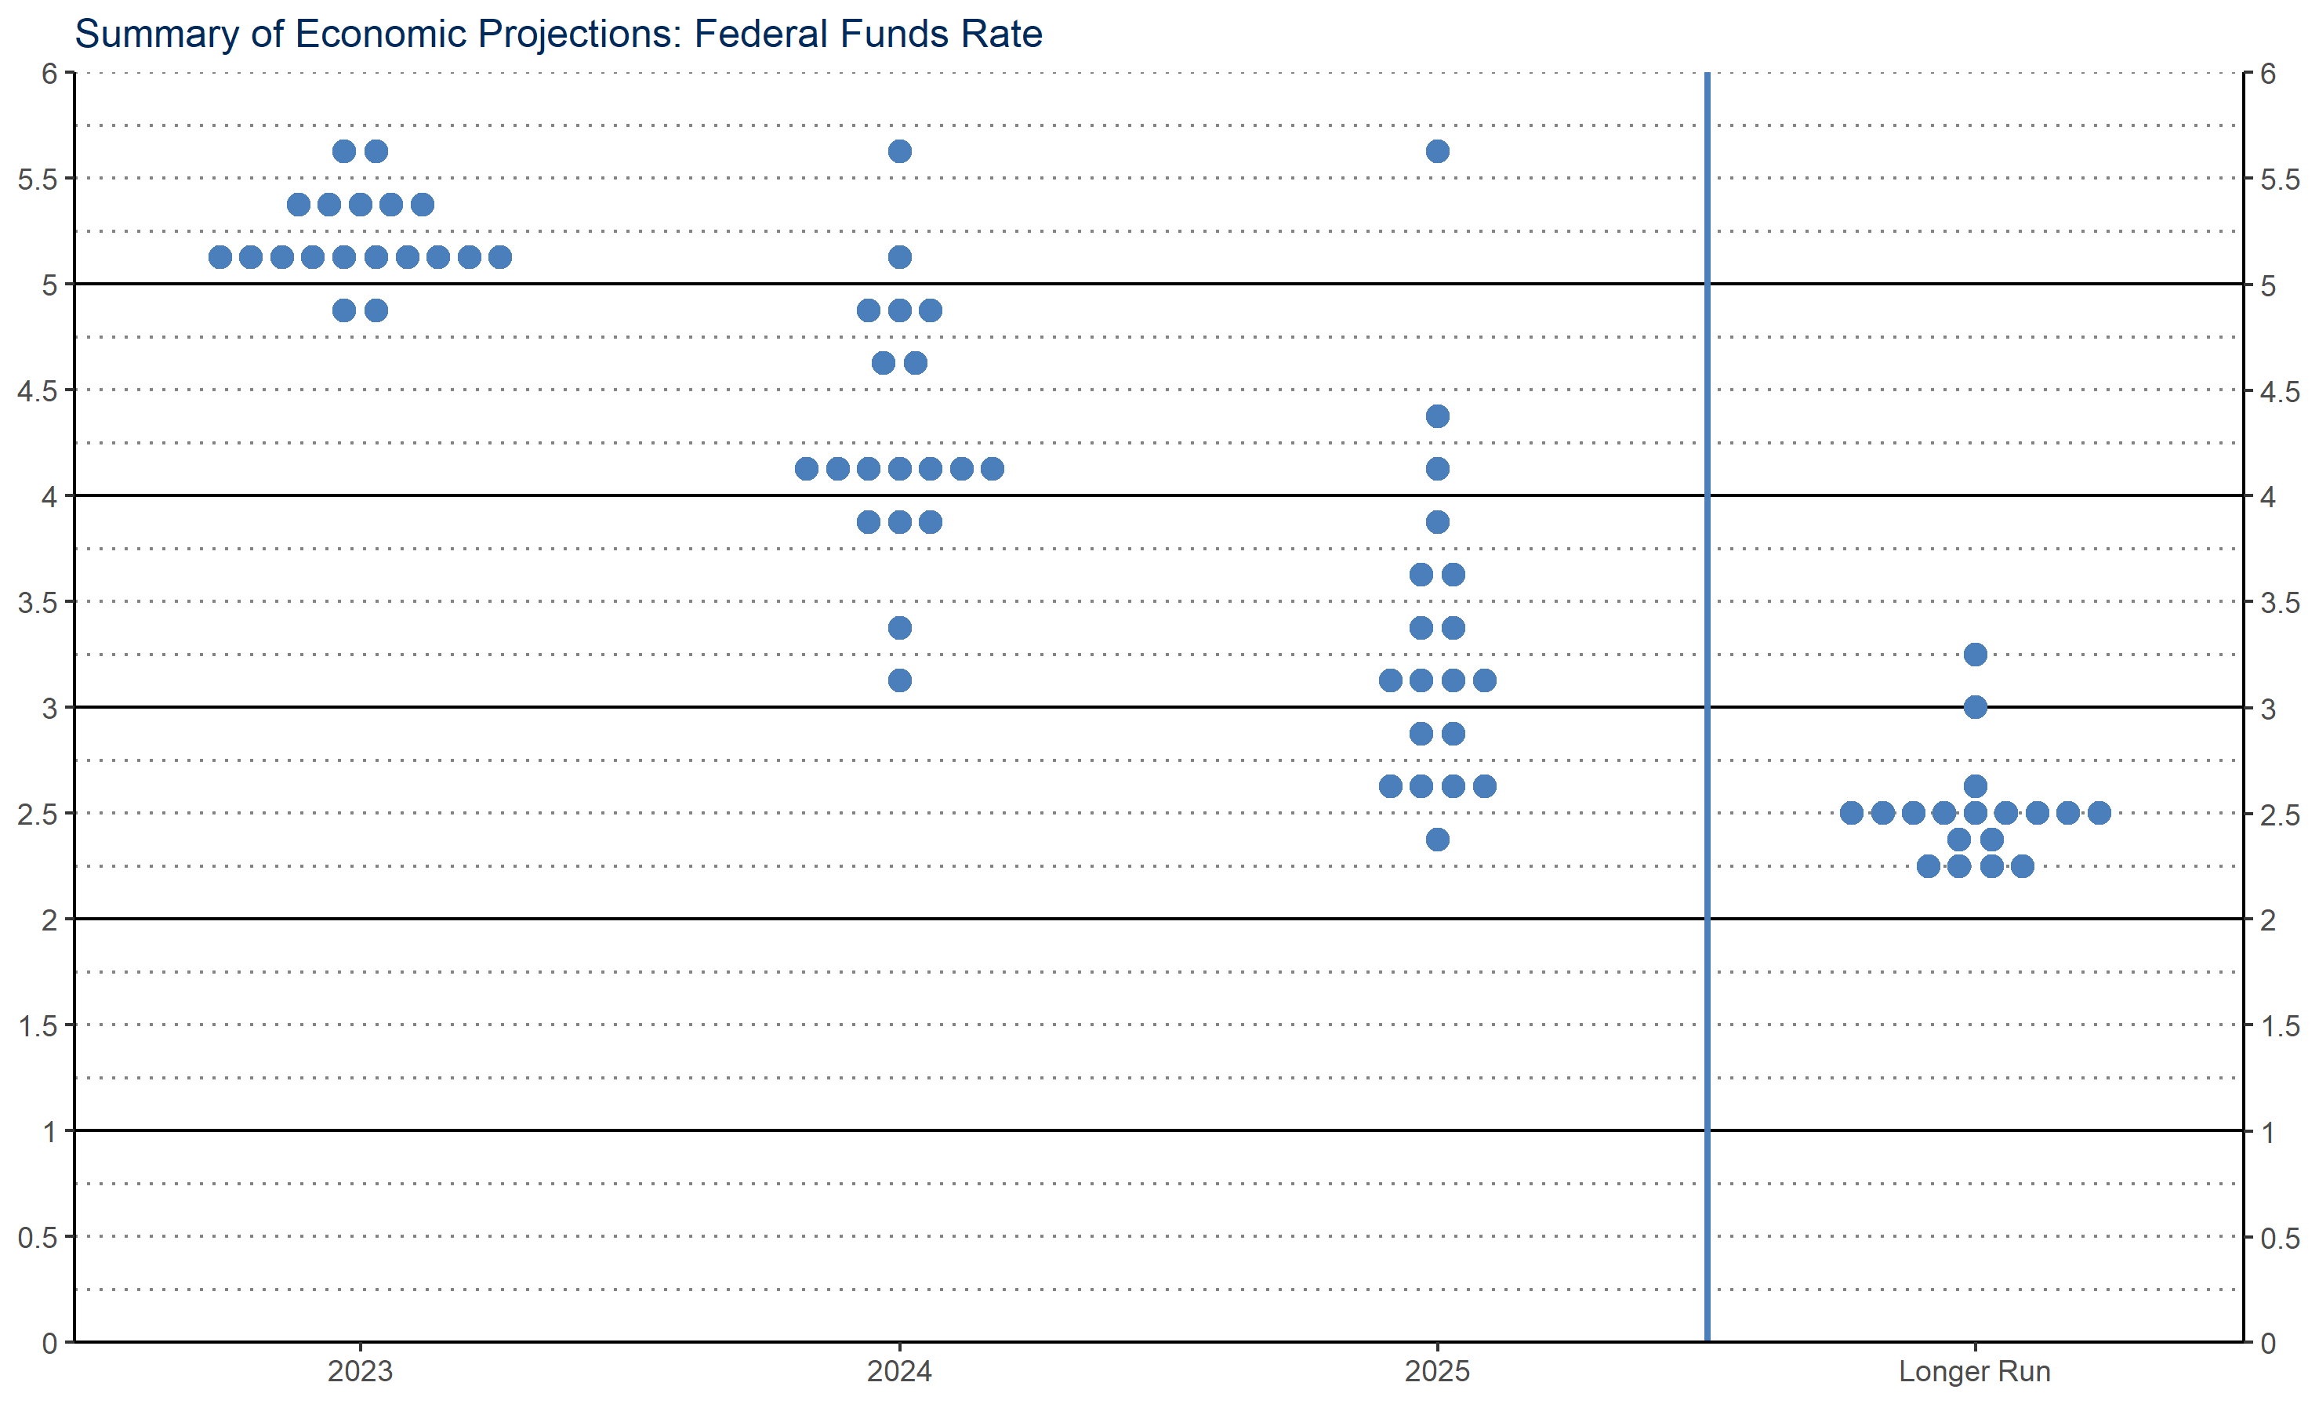
FOMC Projections: Federal Funds Rate
* Where we are today

Slide 7
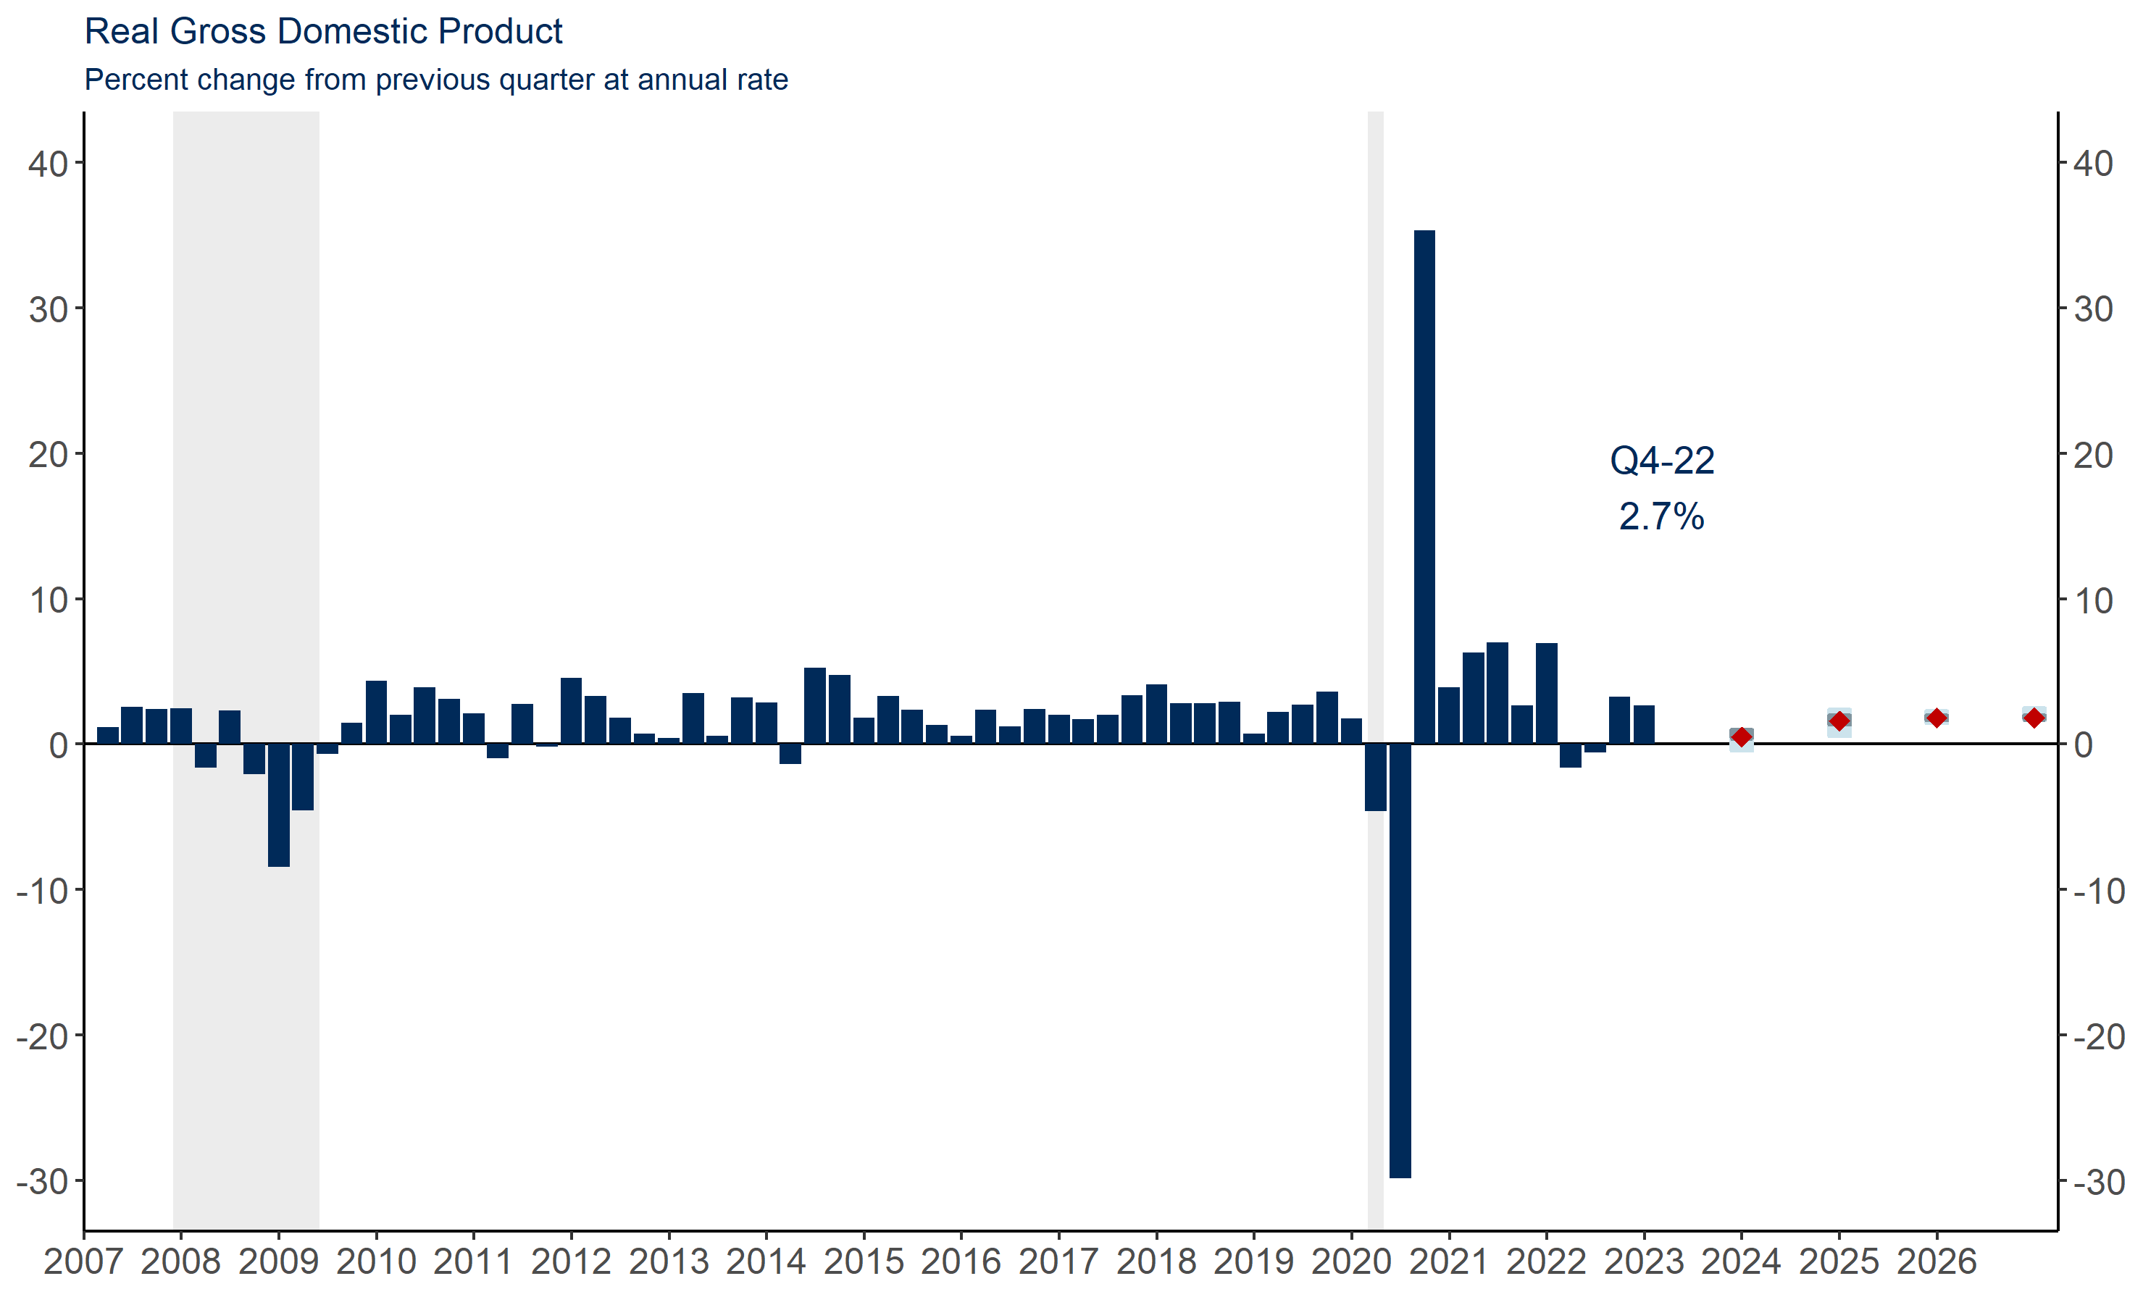
GDP growth was surprisingly strong in the second half of 2022
Source: Bureau of Economic Analysis/Haver Analytics, Federal Reserve Board

Slide 8
Consumer spending is holding up, but housing is hurting
Source: Bureau of Economic Analysis/Haver Analytics

Slide 9
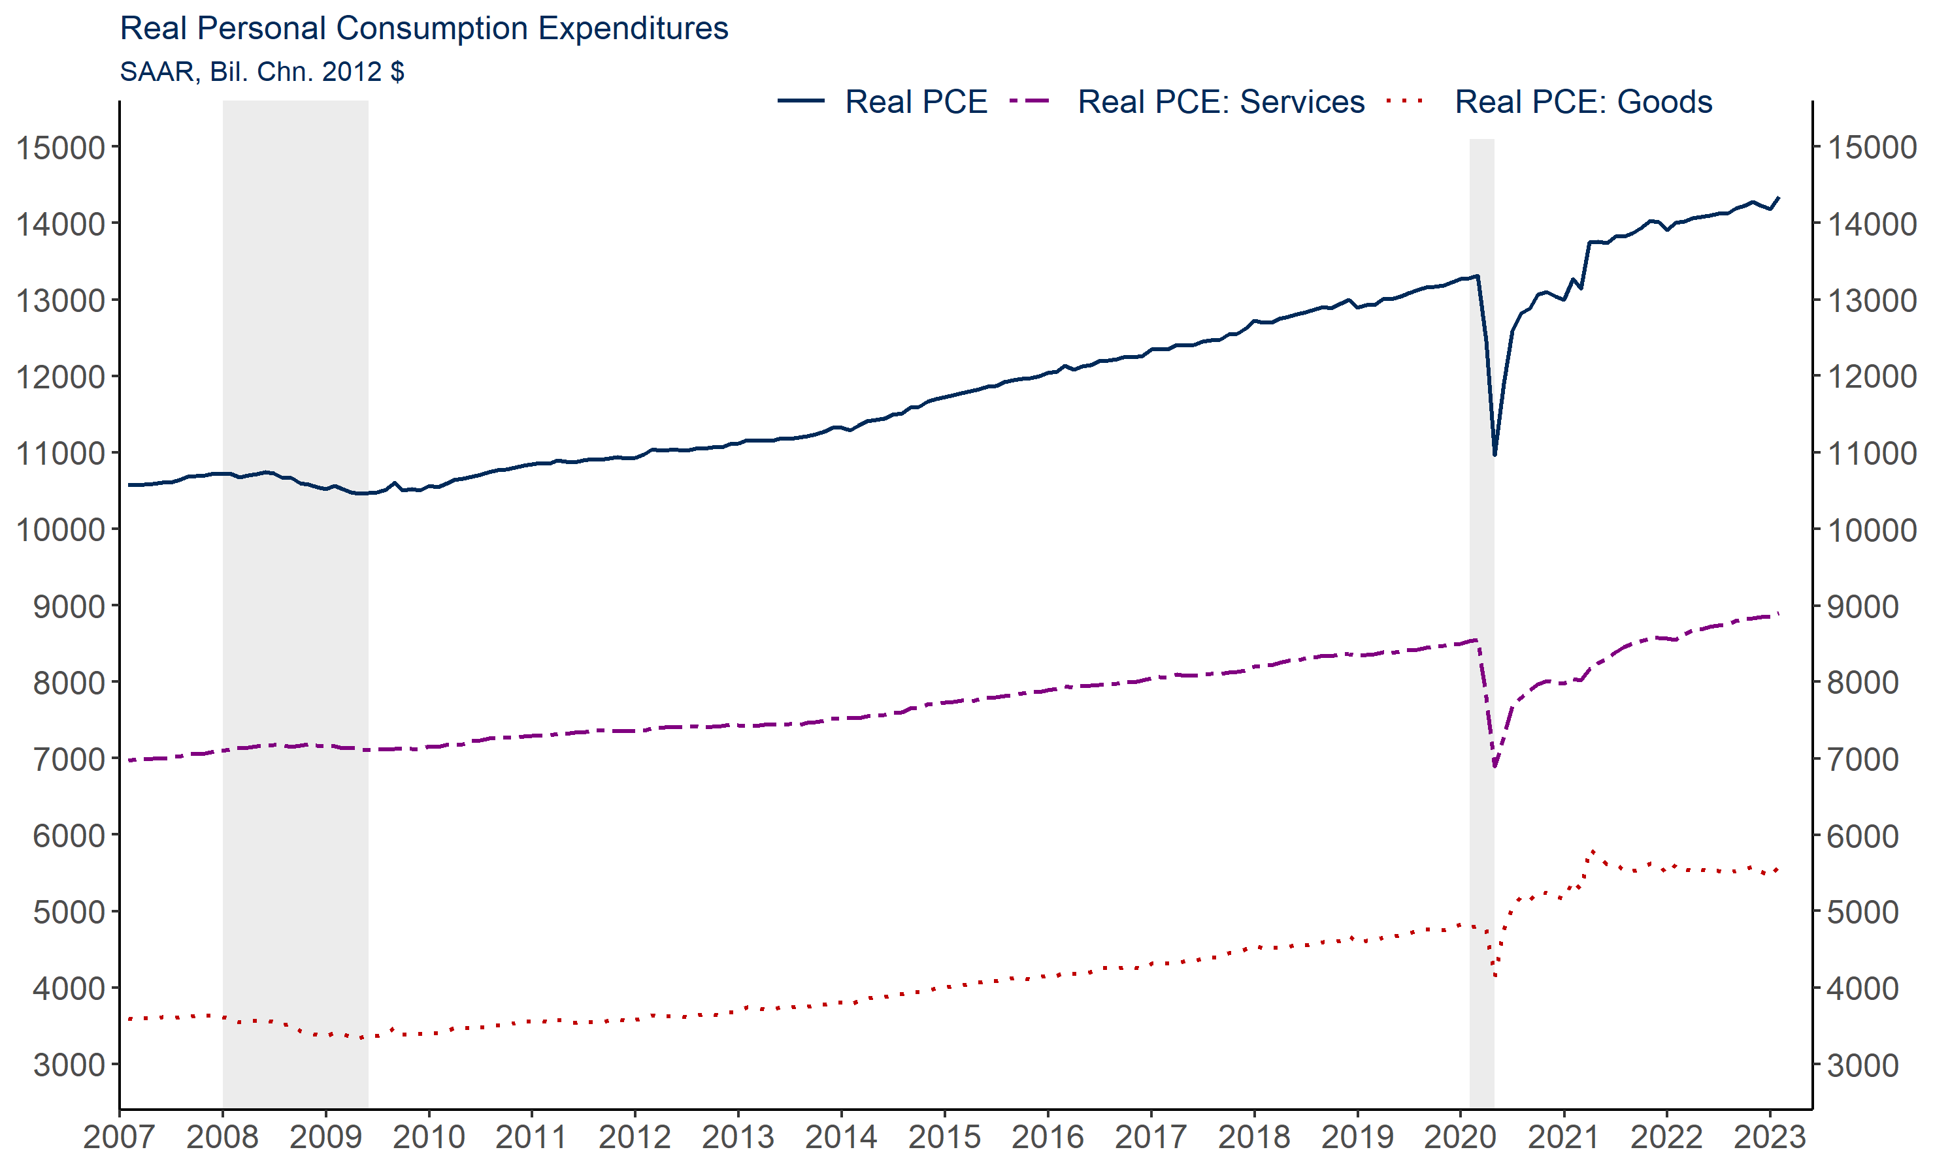
Spending continues to grow at a steady pace and has shifted back to services
Source: Bureau of Economic Analysis

Slide 10
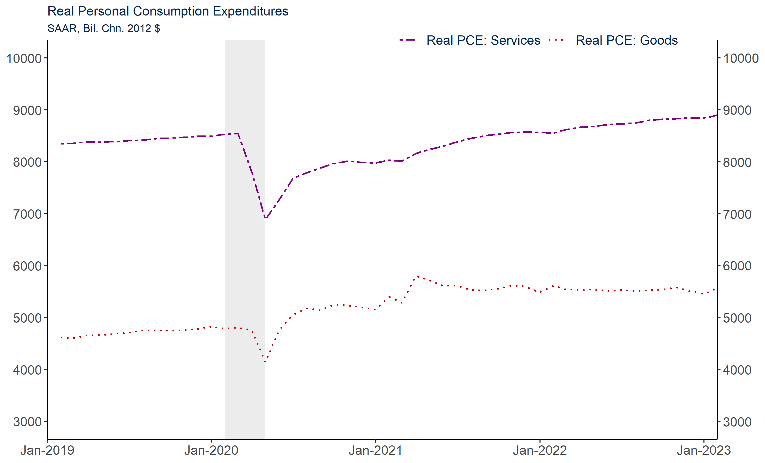
Zoomed in view
Source: Bureau of Economic Analysis

Slide 11
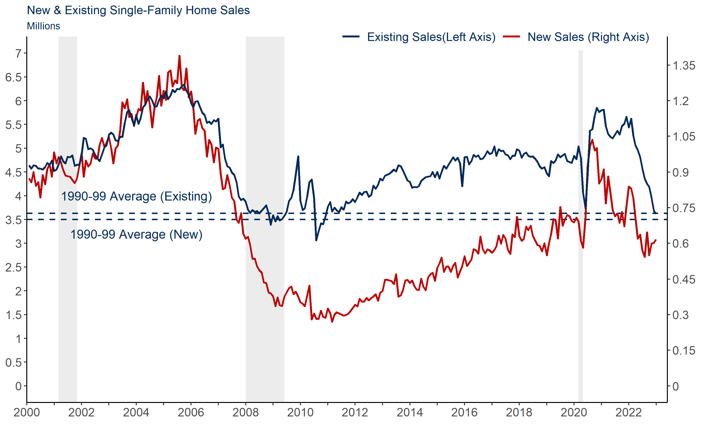
New and existing home sales have fallen; due in part to low inventory levels and rising interest rates

Slide 12
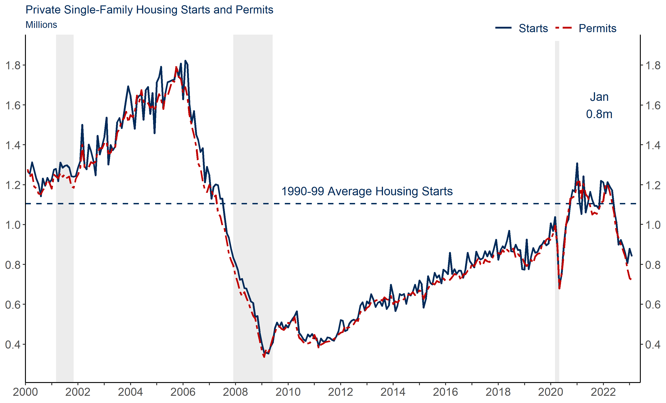
Housing starts and permits have also declined sharply

Slide 13
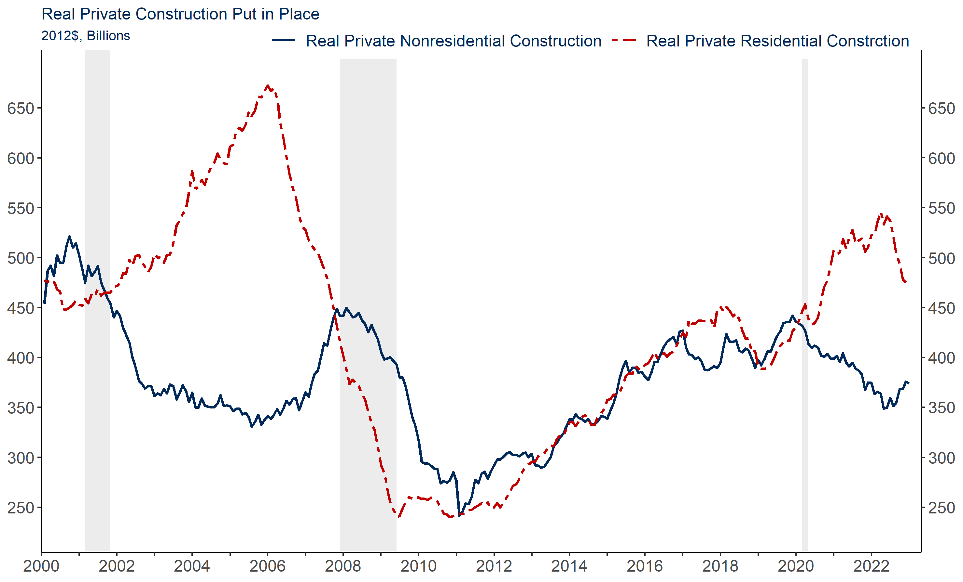
Real nonresidential construction had been slowing for a while picked up over the last six months

Slide 14
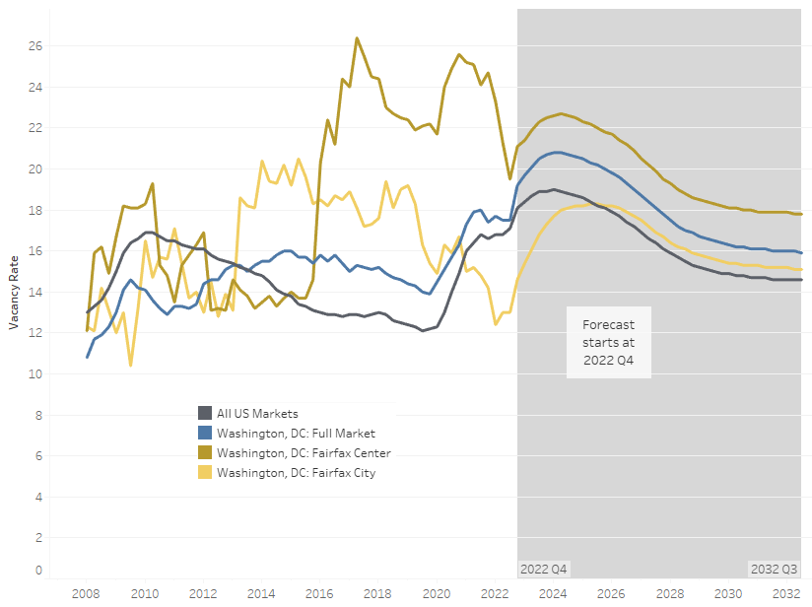
Office vacancies expected to rise across the DC MSA, but vacancies vary by sub-market

Slide 15
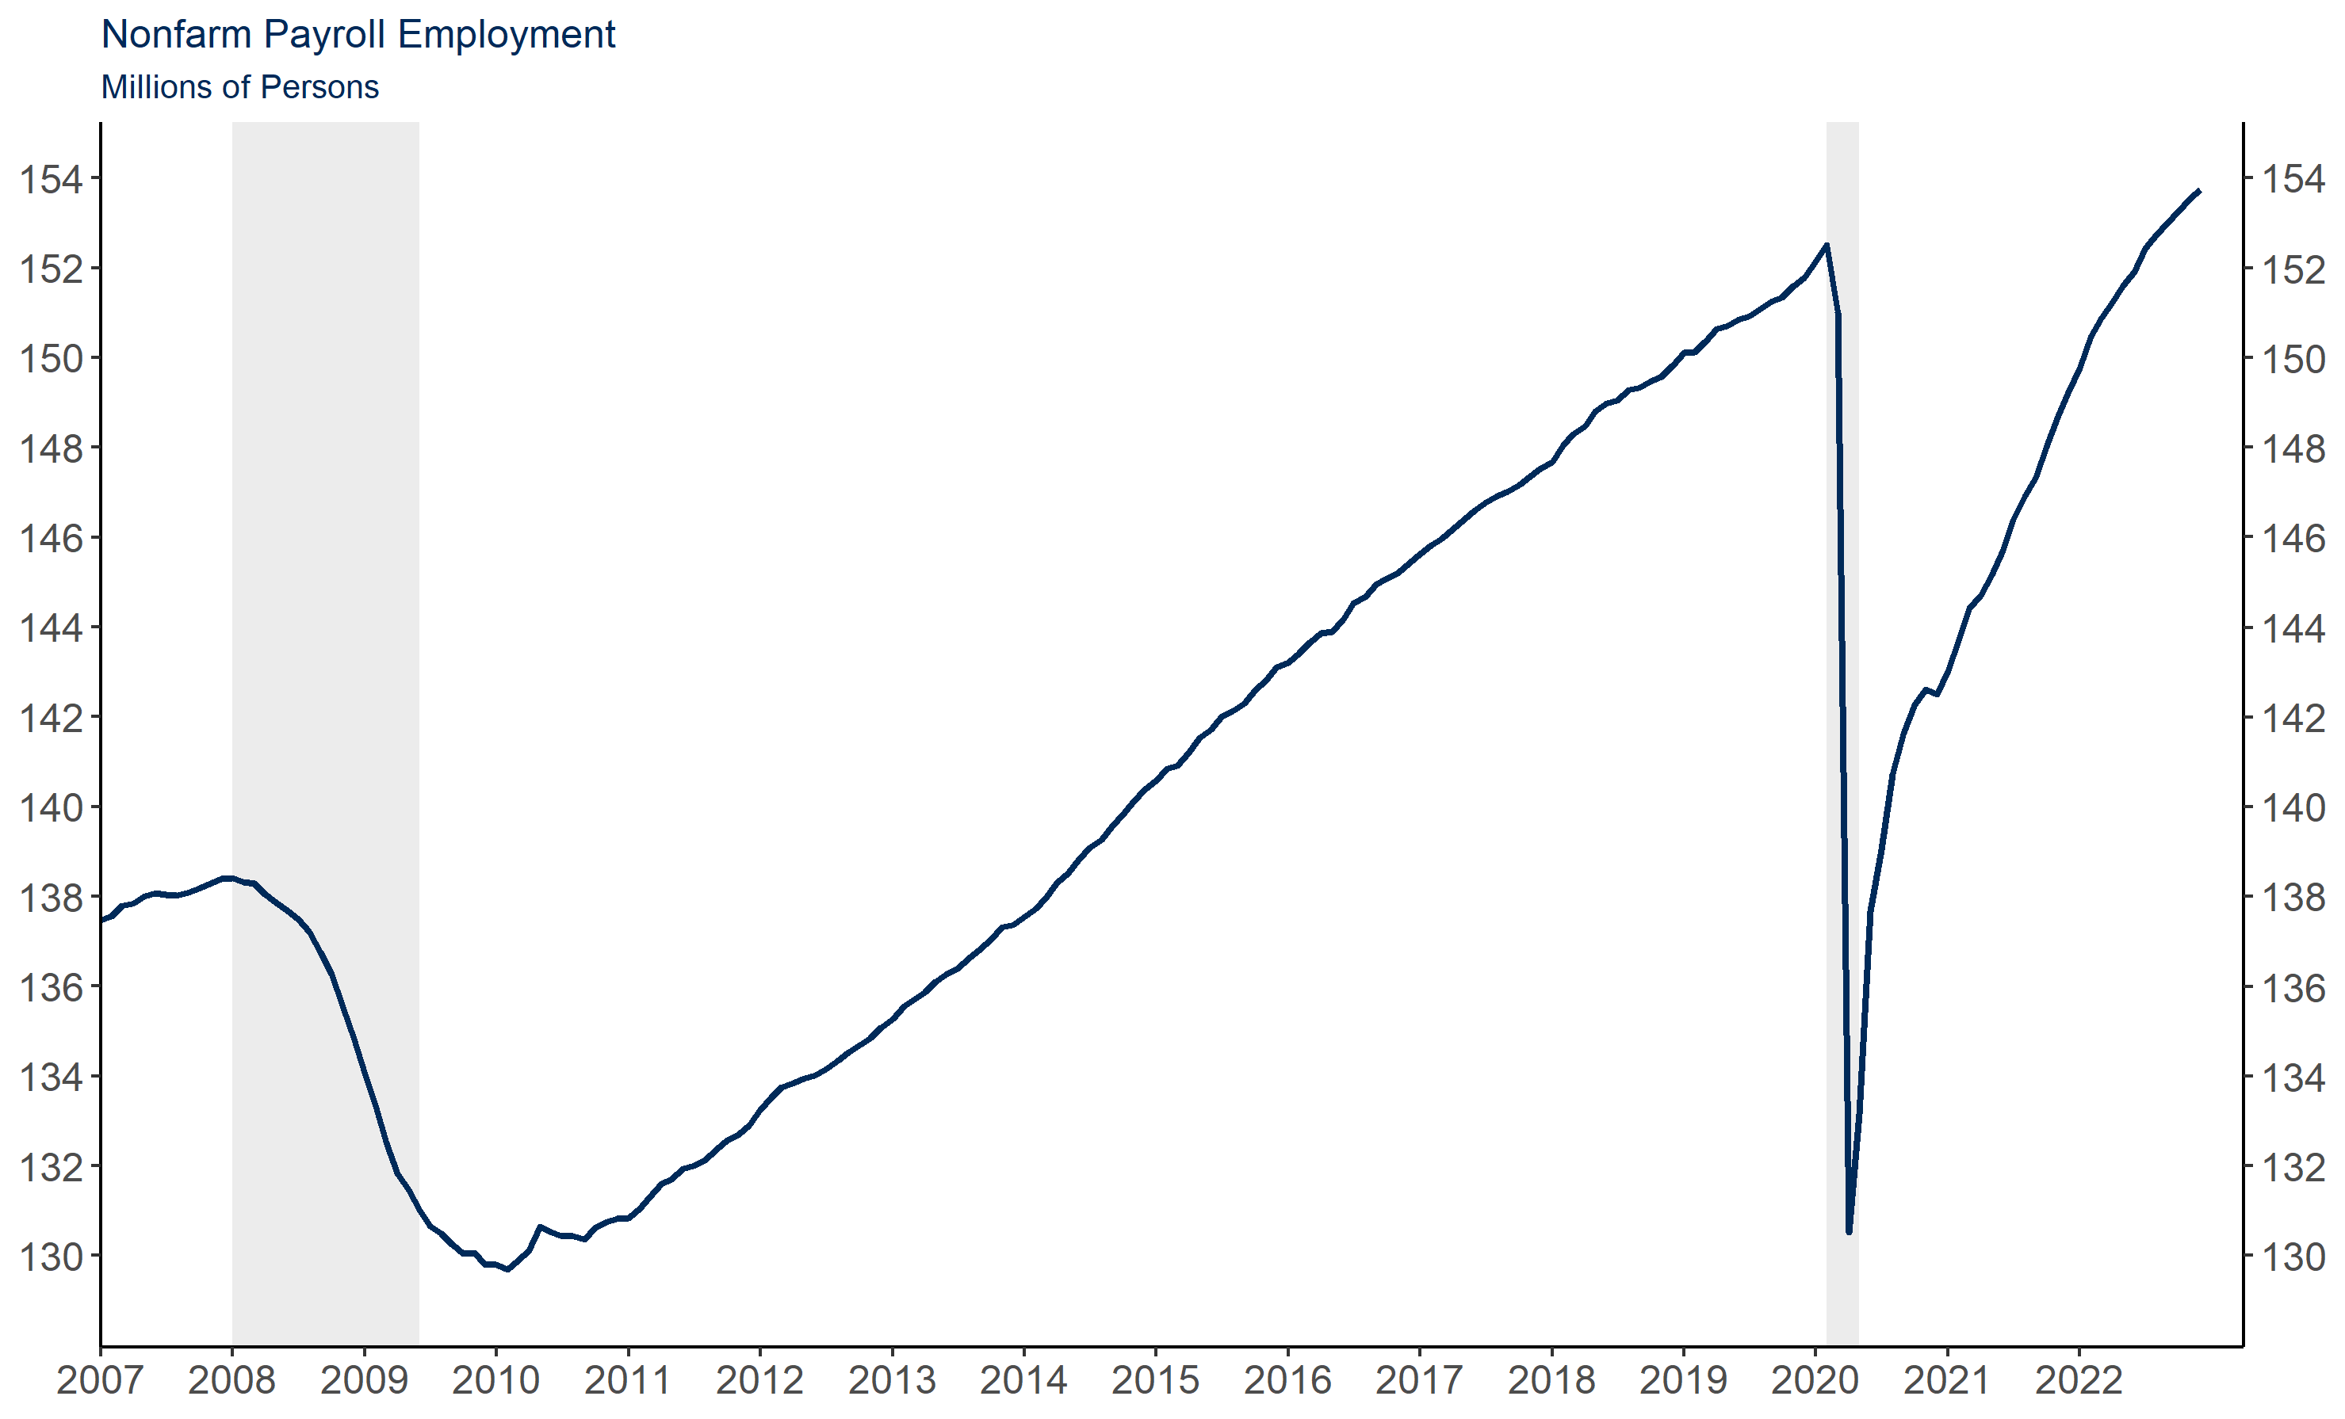
We are now above pre-COVID levels of employment nationally, but we haven’t returned to the pre-COVID trajectory
Monthly Change (in Thousands):
January 23: 517
December 22: 260
November 22: 290
October 22: 324
September 22: 350
August 22: 352
July 22: 568
June 22: 370
May 22: 364
Source: Bureau of Labor Statistics/Haver Analytics

Slide 16
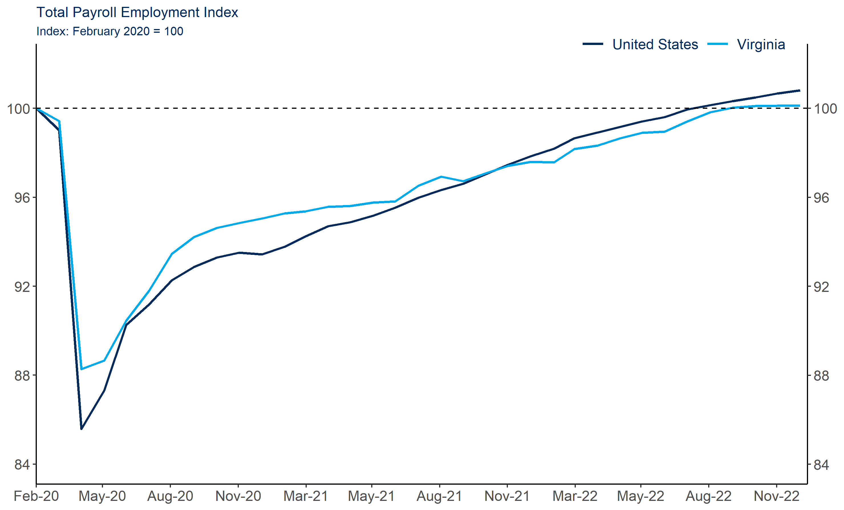
Virginia employment growth is lagging the nation

Slide 17
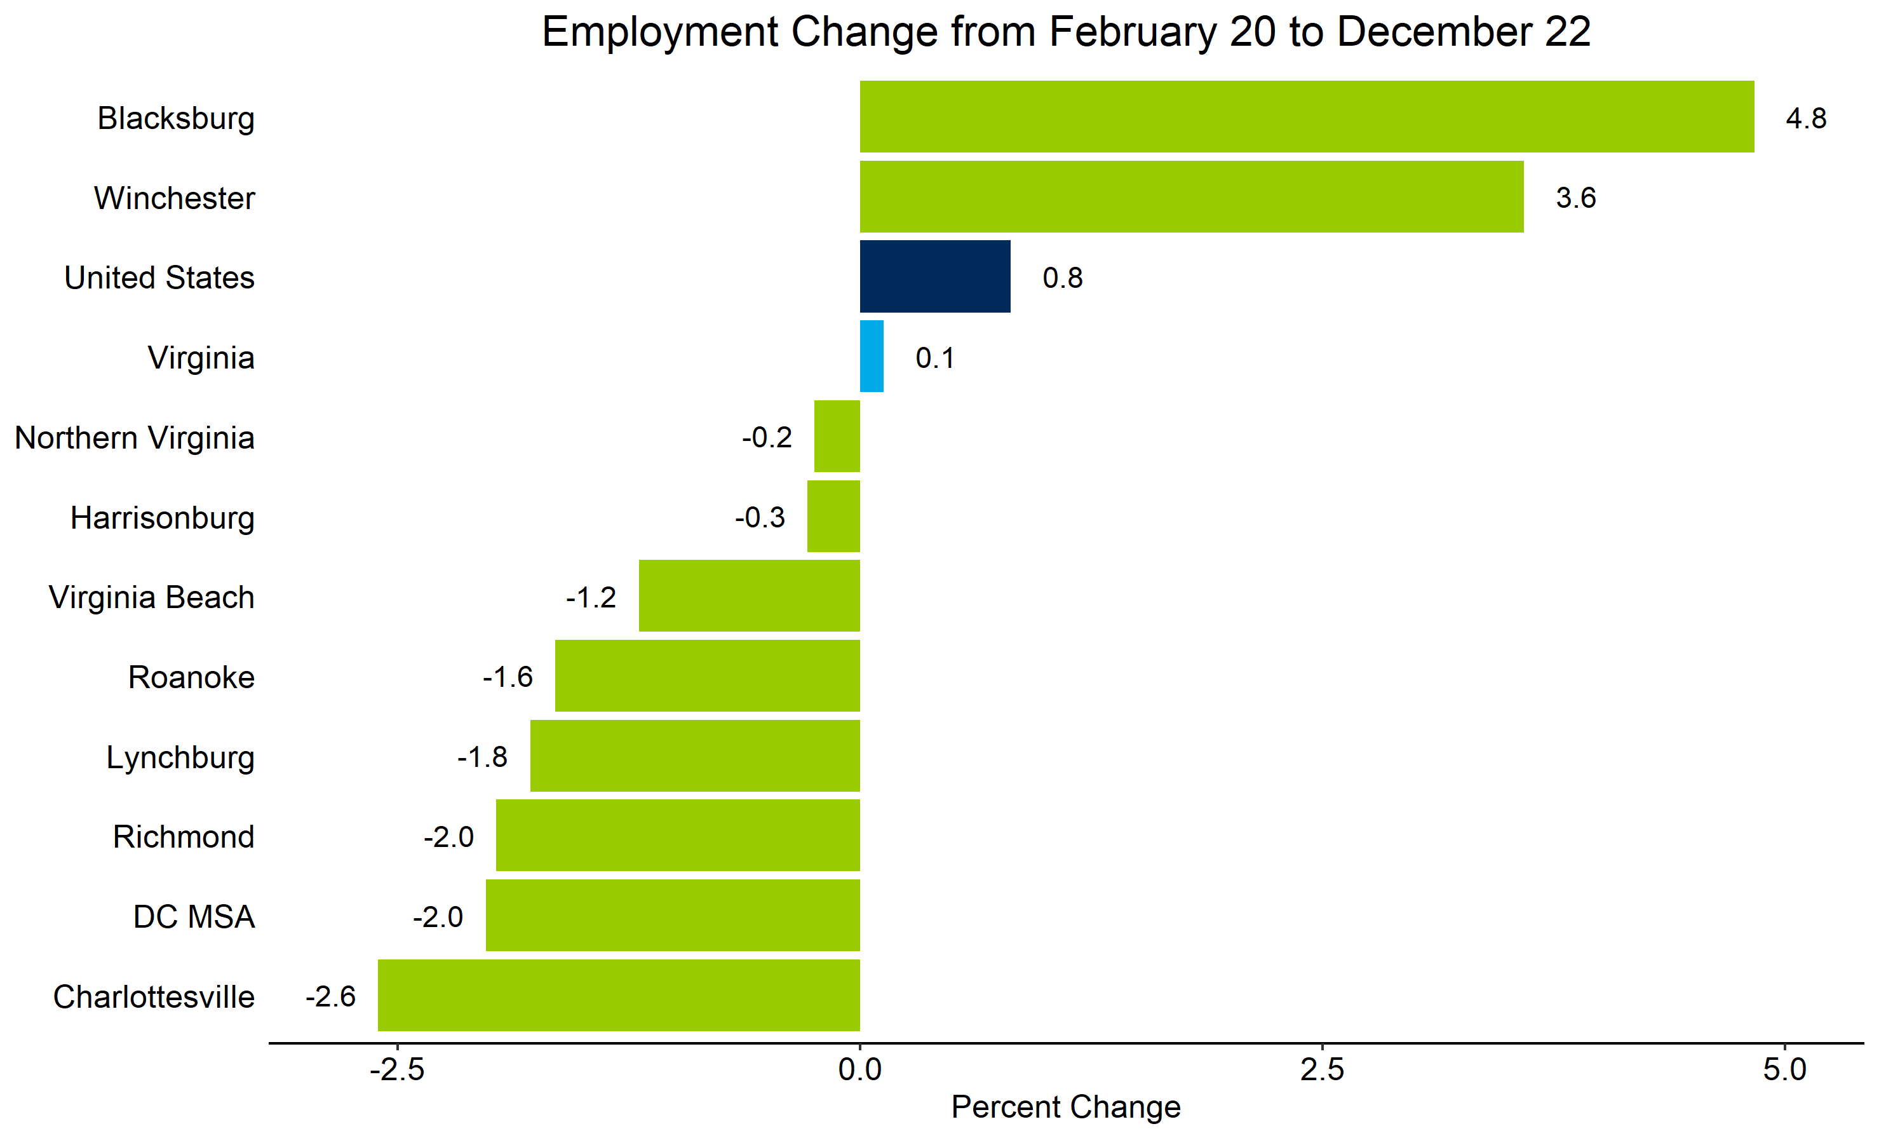
Most metro areas are well below pre-covid employment; NOVA getting close

Slide 18
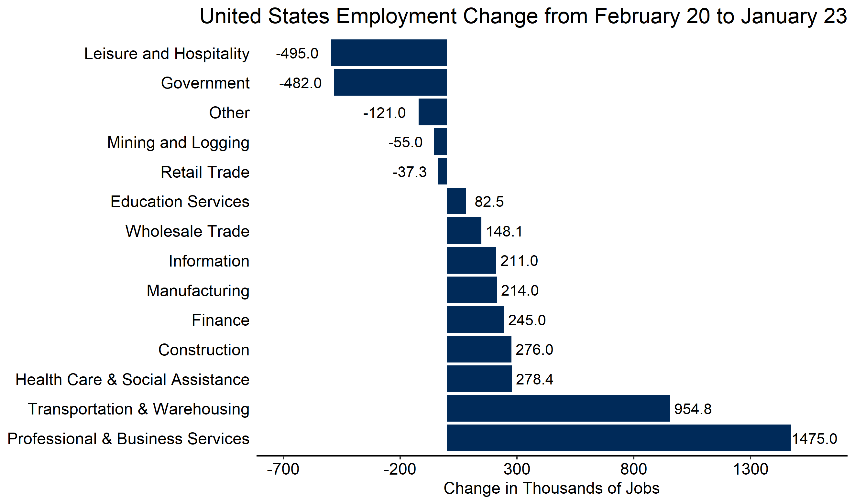
Nationally, Leisure & Hospitality and Government are the only two sectors that are still down considerably

Slide 19
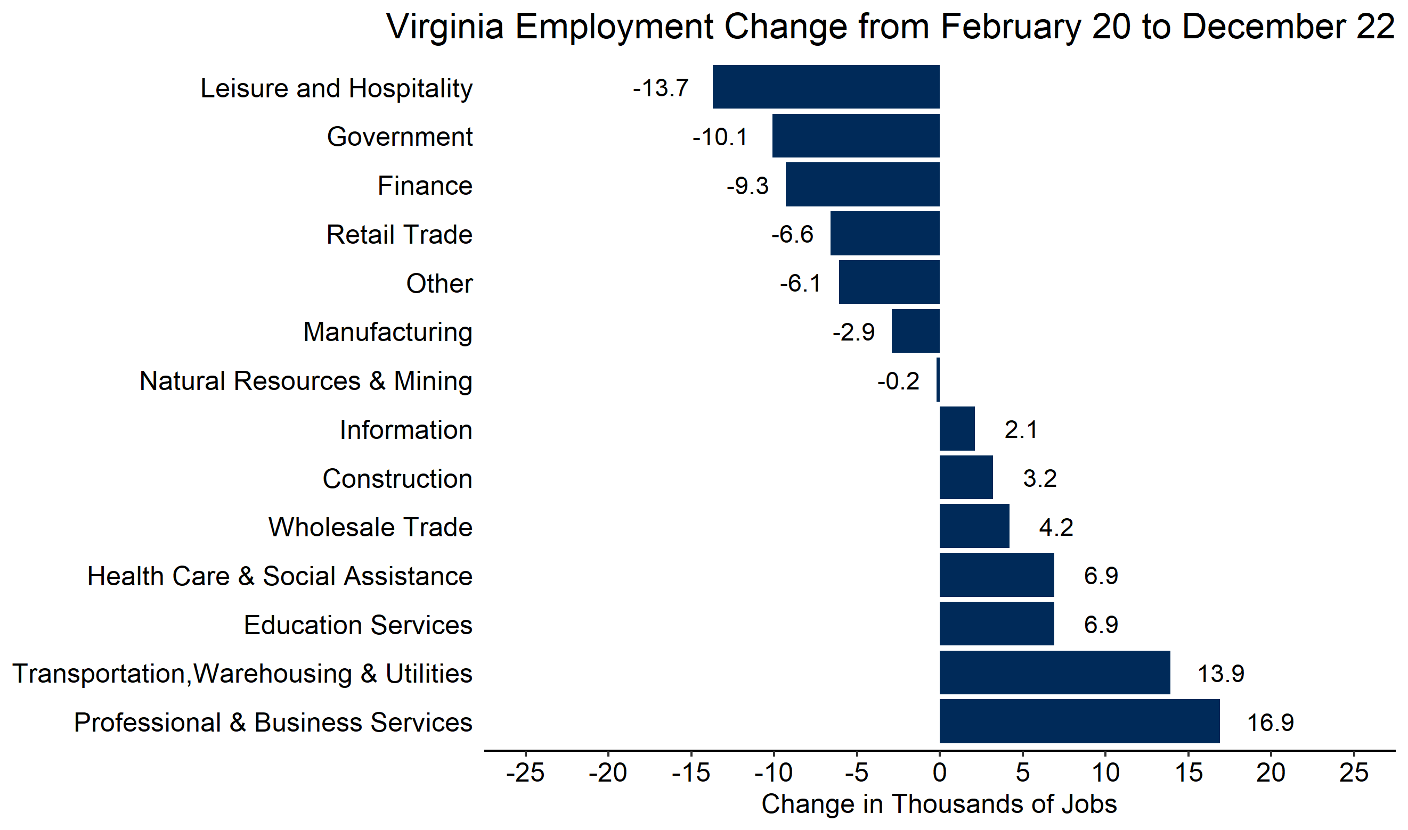
More sectors in Virginia are well below pre-pandemic levels

Slide 20
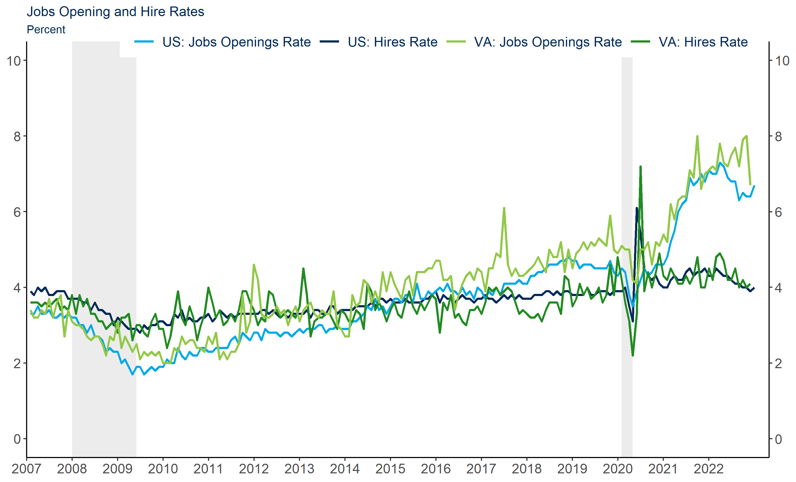
Job demand in Virginia is strong; higher than the national rate

Slide 21
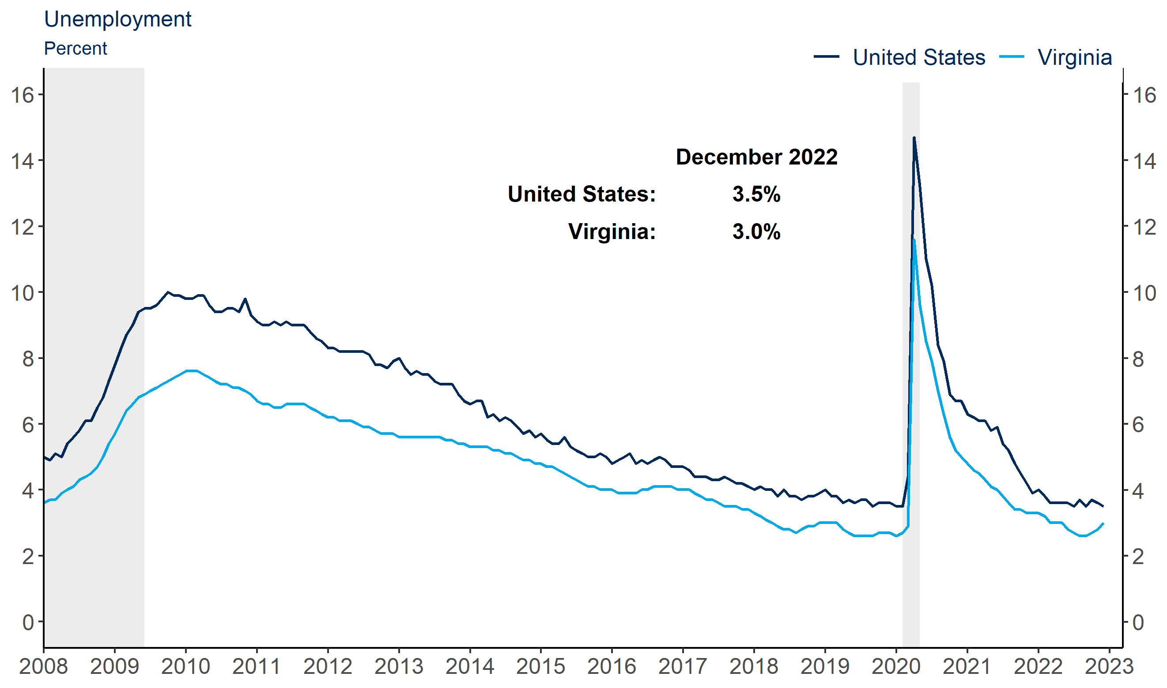
But the supply of labor is tighter in Virginia
Source: Bureau of Labor Statistics/Haver Analytics

Slide 22
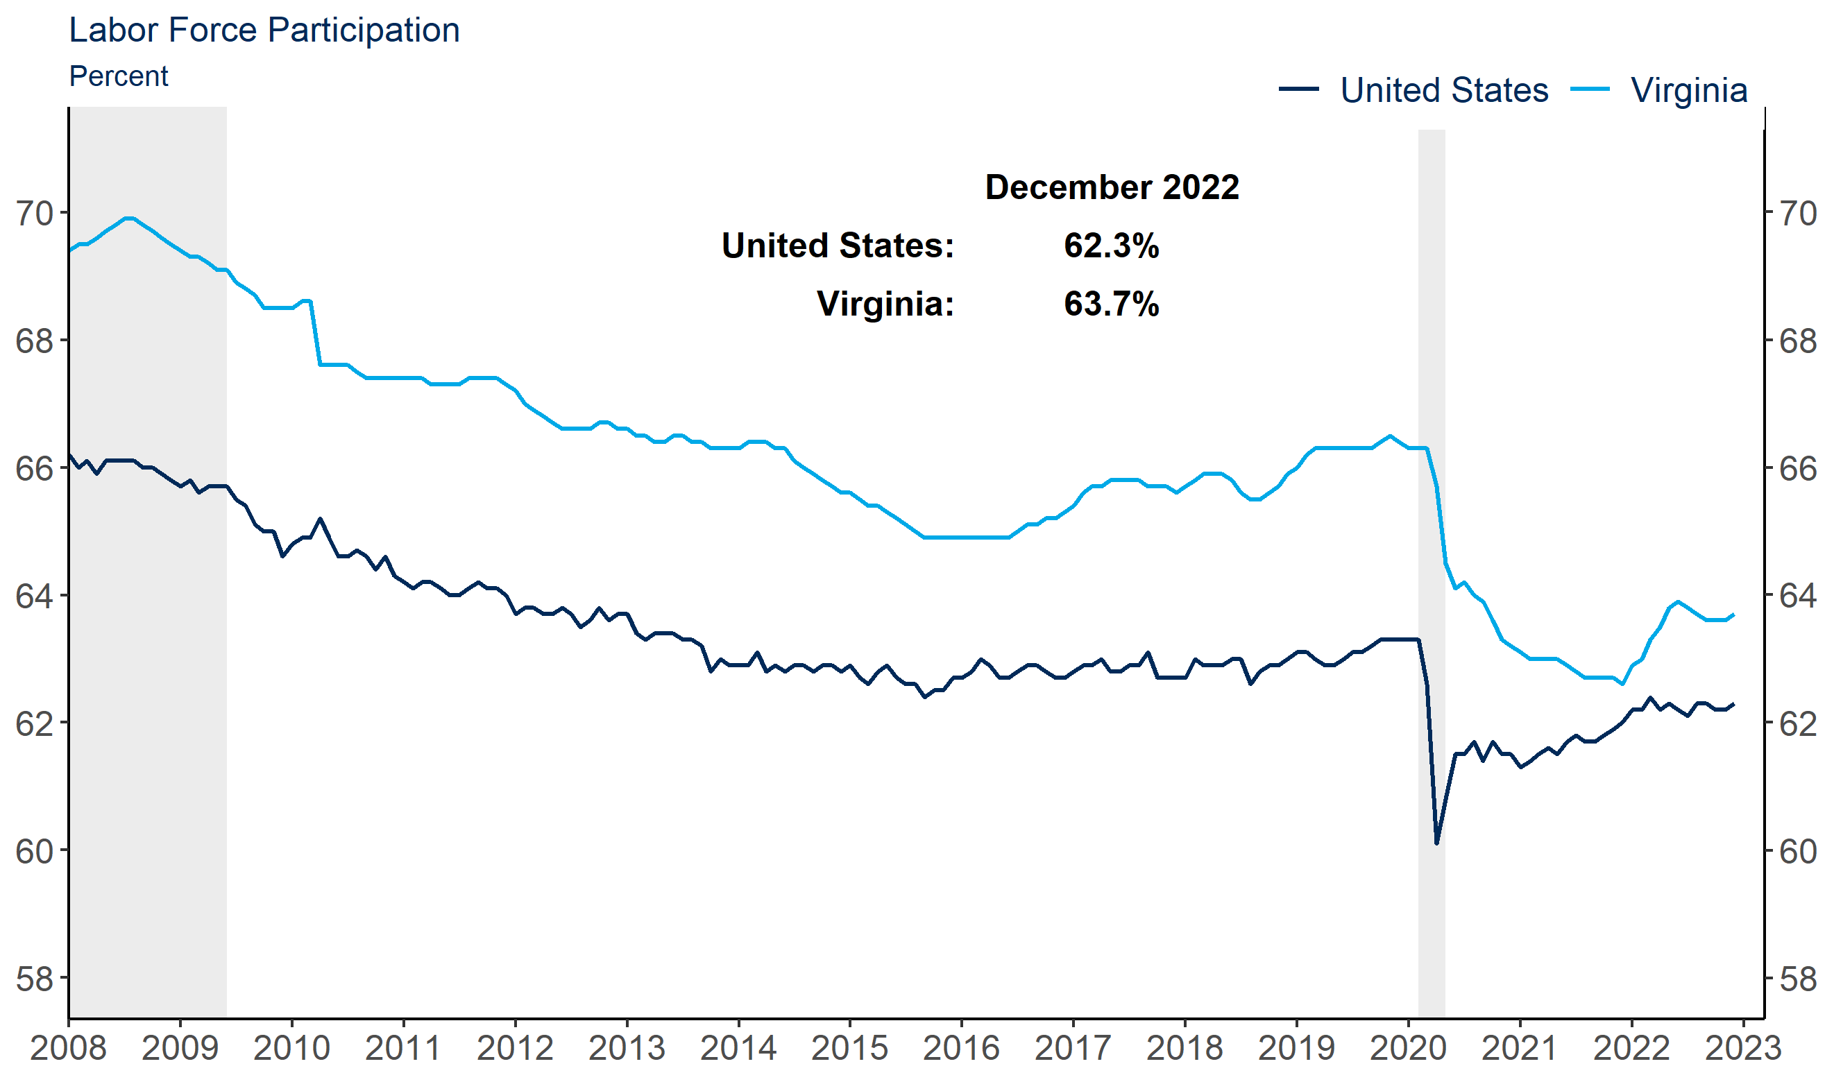
And more Virginians have left the labor force
Source: Bureau of Labor Statistics/Haver Analytics

Slide 23
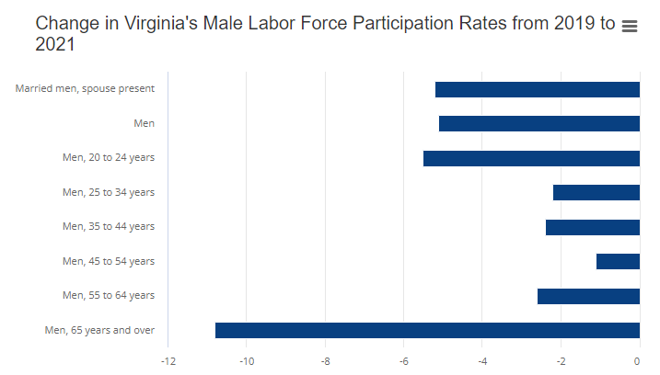
Men in particularly, and largely men over 65

Slide 24
Where do we go from here?
Economic growth in 2022 ended better than expected. Growth for 2023 is forecasted to be roughly flat. There are significant potential speedbumps ahead.
  Geo-political issues, especially the situation in Ukraine
  Inflation that significantly exceeds current policymakers’ expectations
  Anything that makes supply chain issues even worse
  A COVID variant that evades vaccines and is more severe
What happens to employment in the coming months? Will we see a real softening of labor demand?
The FOMC has already raised rates considerably and seems poised to be as aggressive as is needed to return inflation to close to the 2 percent average target.
  How high will rates need to go in order to recede inflation?
  It remains unclear whether or not the Fed will be able to achieve a “soft” or “softish” landing.

Slide 25
Thank you!
Joseph.Mengedoth@rich.frb.org

