Slide 1
Companioning Grief
Chaplain Gina Maio
Nayar Healthcare and Hospice, LLC
Notes:
An honor to be here. Thank you.
Relevant for today? Are we talking more about death than ever before?
Ex. Hospice Foundation of America resources, “Living with grief since covid-19”.
There is a distinction, a uniqueness for us, you and I.
Part of people’s lives before death, a part of planning and preparation, and then after death.
Companioning Grief!

Slide 2
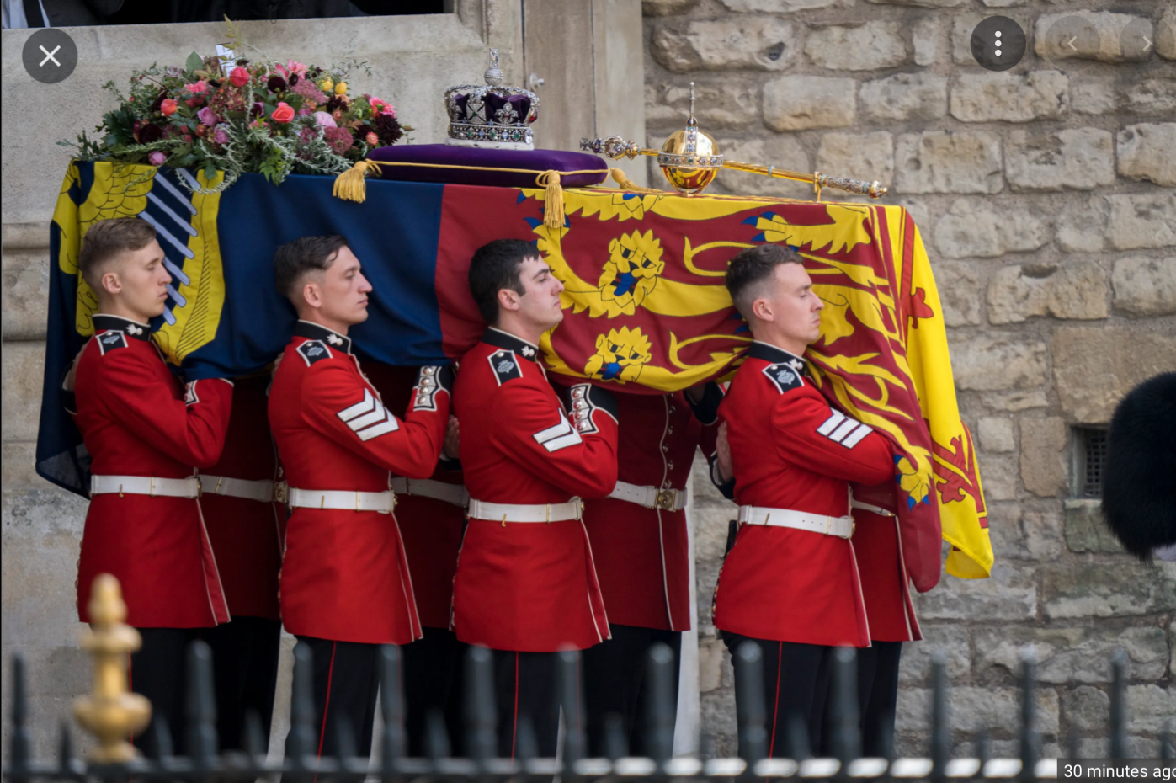
A funeral……

Slide 3
Trust Attorneys, Officers or Estate Planners
Hospice Chaplains/Spiritual Care Coordinators
Notes:
Definition from Jeff. SCC: hospice teams’ link to the community regarding spiritual care of the dying and their families. Dedicated to journeying with and providing the patient, or family, with the care and spiritual counsel to meet their stated needs.
Death and Taxes! What else do we have in common? (2) Moments of CALM (hospice can last for years!) and CRISIS (when someone has died). (3) All ages. (4) Reasons for meeting differ greatly. (5)Anything else? Have you ever had a meeting with someone grieving go really wrong? A little wrong?
Tonight, thoughts on serving the grieving. Companioning with them.

Slide 4
Profound listening
Gathering meaning from the all the senses (sight, sound, touch, feelings, smell). Listening in a way that allows us to be touched by life, below the literal fact of things. It is intuition, using our ‘soul’, to better understand our neighbor.
Notes:
St. Benedict wrote in his ‘Prologue to the Rule’ to listen “with the ear of the heart”
Important to companion the grieving.

Slide 5
Christian, saved by the grace of Jesus Christ
Married to Matthew for almost 30 years
Mom of Davis (26) and Mary-Dryden (22)
Ordained Presbyterian Pastor (2011)
Ancestors served as Sunday School Teachers, Music Leaders, and Baptist Preachers (Men only)
Calling the City of Richmond home since 2004 (born in Atlanta, GA)
Virginia Tech, George Mason University, Union Presbyterian Seminary
Teacher, with 20 years serving in secondary education
International Trade and Marketing Teacher-Coordinator, FCPS (11 yrs)
Head of School, Church Hill Academy (9 yrs)
Breast Cancer Survivor (2017)
Serving as a Hospice Chaplain since 2019
Notes:
What can you profoundly listen for, find, just in these words?

Slide 6
TRUST
Notes:
Acronym. Because once a HS teacher, always a teacher!

Slide 7
T is for THINK
How do we think about death? loss? grief?
-Role of Faith? Theodicy questions?
What do we think about death? loss? grief?
-What comes ‘next’?
Notes:
Death = end of something. Loss = maybe it can be replaced?
Grief = our feelings, actions, coping with death and/or loss
How? And What?
THERE IS NOT A STRONG FRAMEWORK IN AMERICA FOR DEATH. (graveyards)
Five “stages”, or symptoms, of grief: Anger. Depression. Bargaining. Denial. Acceptance.
Slow motion…or super speed.
Weeping uncontrollably…or stoic to the point of marble.
Our thoughts on grief, dying, are impacted by our faith. Hebrews 11:1.

Slide 8
“We all know we are going to die, we just think—not in my lifetime”
- Alan Alda, Actor and Activist
Notes:
know /= think. Important for both of us!
A good companion is: humbly confident.
We ALL have problems with death! NO one is fully prepared.

Slide 9
“Grief is the price we pay for love.”
Queen Elizabeth II, in the aftermath of 9/11

Slide 10
R = Resources
Kate Bowler’s books and “Everything Happens” podcasts
Atul Gawande Being Mortal
Tish Harrison Warren Prayers in the Night
Martha Hickman Healing after Loss, a daily devotional
Alan Wolfelt Finding the Words
Notes:
Resources make me happy!
GIVE AWAY WOLFELT to WORST MOST RECENT SITUATION.
BUT all the best resources….don’t take the place of You. Best resource is yourself. “U”. Be careful of “U”.

Slide 11
U
You Illuminate
Notes:
Best resource is yourself. “U”.
As a companion, Your grief experiences only allow you to better clarify potential issues for them. Be careful of “U”. EVERY LOSS IS UNIQUE. DIFFERENT.
A death is not about you, and if you find you make it that, that you are doing more of the grief talk, you need to talk to someone. You have unresolved grief issues.
Jay’s untimely death = questions to ask. Are you sleeping? Slow motion? Is there conflict with your sibling over how you are reacting?

Slide 12

S is for…
Say Something!
3 things
Compassionately honest
Authentic.
Action?
Notes:
3 things.…maybe in writing ahead of time
Compassionately honest….easy if they were a lovely person. Hard if they were an ass.
Grumpy. You father always stated and knew what he wanted. I never had to guess.
Miserly. Penny pinching. Your father knew how to save his money.
And if you can’t find anything kind to say to someone who is grieving…you need counseling. You are burned out.
Wilbur QUOTE
Authentic….if you are not warm and fuzzy, don't say things that only a warm and fuzzy person would say.
Action? Maybe Ted Lasso example

Slide 13
TRUST
T
Notes:
REVIEW prior points. Then, TRUST.
Trust yourself
Trust, but verify. Ask. EXAMPLE!
Trust, but don‘t go it alone. Touch may be appropriate. May be what people need. Ask first. Always.
Tissues.
They trust you…Ethics—$ grabbing? Use kindness.
Trust me, that may get angry at you, but it probably isn't about you, but their grief.
Trust = John 14:1. Question in this chapter. How? Why? What? Vs 27 “I am leaving you with a gift—peace of mind and heart.”

Slide 14
100%
Notes:
As their companion…We all will die. You can trust in death. No one gets out of this life alive. Everyone will deal with grief.
If you’re not getting older, you’re dead. —Tom Petty

Slide 15

Notes:
Companion on the journey. Example of (1) Past, present, and future.
(2) NATURE offering hope.

Slide 16
Questions? Thoughts?

Slide 17
A poem from
“The Cure for Sorrow”
by Jan Richardson

Slide 18
the blessing of asking, sharing, listening….
being present.
Notes:
the power of presence.

Slide 19

Thank you
Contact:
Nayar Healthcare and Hospice, LLC
4102 East Parham Rd., Suite C
Henrico, VA 23228
gmaio@nhc.life
www.nhc.life
804.330.5433 (office)
804.916.9667 (cell)

